Slide 1
State and County Proficiency Estimates using PIAAC Skills Map

Slide 2
Presentation Outline
Introduction to the U.S. PIAAC Skills Map
Where do these data come from?
What types of questions can the U.S. PIAAC Skills Map answer?
How can you download the Skills Map data to answer further questions?
Resources for future use

Slide 3
Introduction to the U.S. PIAAC Skills Map
Notes:
https://vimeo.com/401012065/33f4b8655c

Slide 4
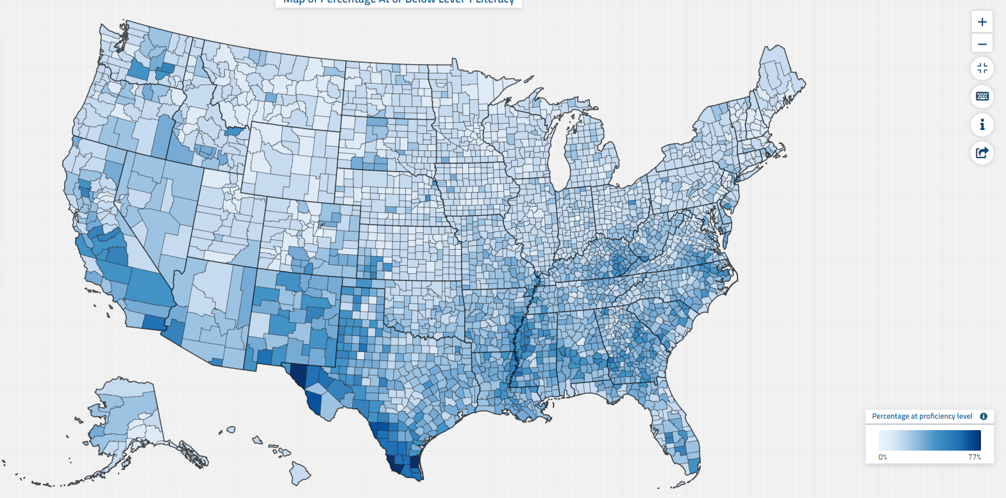
The U.S. PIAAC Skills Map: State and County Indicators of Adult Literacy and Numeracy
NCES’ new Skills Map is an online tool that provides the most comprehensive data on the literacy and numeracy skills of adults age 16–74 in all 50 states, the District of Columbia, and for all 3,141 counties.*
*Using the U.S. Census Bureau’s definition of “county” for statistical purposes.

Slide 5
Where do these data come from?

Slide 6
Why Small Area Estimation
PIAAC, as collected, cannot report on the county or state level
NCES saw a need for and an interest from the stakeholders for reliable estimates of skills of the adult population that would be representative at the local levels.
In the absence of any other proficiency assessment data for individual states and counties, NCES developed a statistical model to provide a general picture of proficiency for all states and counties.

Slide 7
Small Area Estimation
The statistical model used a technique called small area estimation.
This statistical model relies on data from:
The Program for the International Assessment of Adult Competencies (PIAAC)
The American Community Survey (ACS)

Slide 8
Program for the International Assessment of Adult Competencies
PIAAC is an ongoing international study of adults that measures the basic cognitive and workplace skills such as literacy and numeracy
NCES conducts PIAAC in the United States
The model uses PIAAC combined data from 2012, 2014, and 2017

Slide 9
American Community Survey
ACS is a nationwide survey that provides data on the social, economic, housing, and demographic characteristics of the U.S. population every year
ACS is conducted by the U.S. Census Bureau
The model uses ACS data from 2013-17 to improve the precision of the estimates

Slide 10
How reliable are these estimates?
As this is a sophisticated model for small area estimation, NCES consulted with a panel of experts to ensure it reflected the most recent research.
NCES used a variety of methods to validate the estimates. Estimates were found to be consistent across varying scenarios.
NCES used the direct (or actual) PIAAC results to validate the estimates from the model. The small area (county) estimates and direct results were found to be comparable.

Slide 11
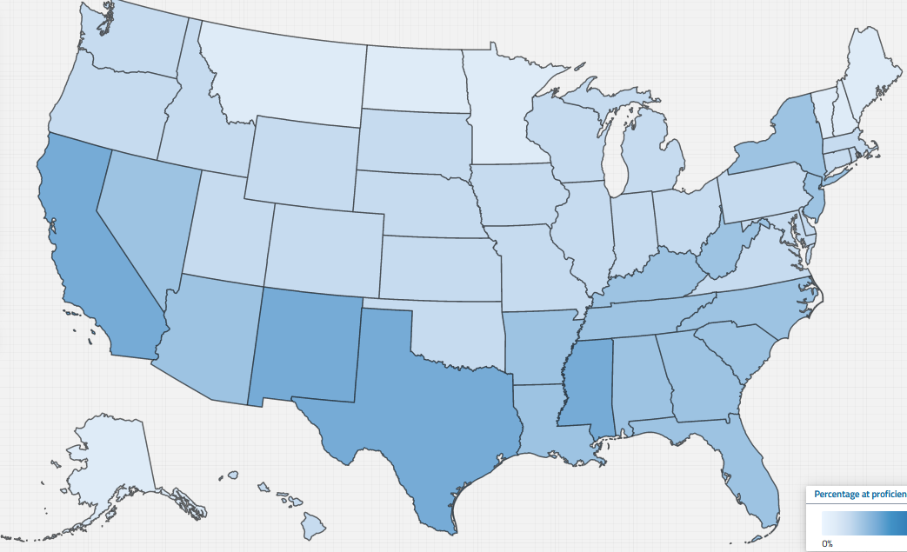
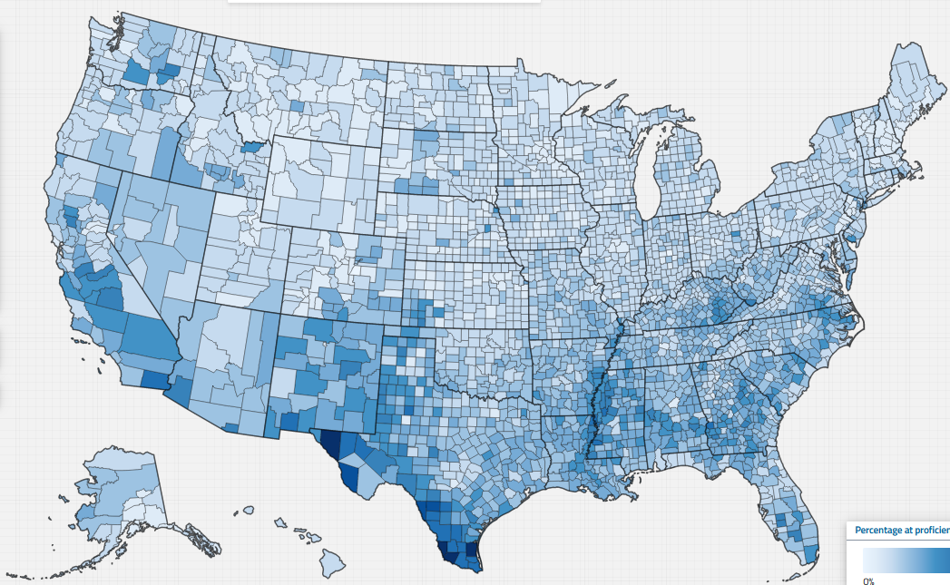
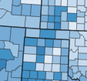
What information is available in the Skills Map? – Skills Estimates
State
County
Percentage in Proficiency Levels
Average Scores
Literacy
Numeracy

Slide 12
What information is available in the Skills Map? – Contextual Information
Selected demographic variables from the ASC are available for each state and county to provide contextual information along side the skills data. Below are a few examples:
gender
race/ethnicity
educational attainment
English-language ability
foreign-born population
employment status
occupation
poverty level
health

Slide 13
What information is NOT available in the Skills Map?
Digital problem-solving estimates are not available
Analyses of state’s subpopulations such as estimates of literacy or numeracy by age, gender, race, or other demographic characteristics – are not available

Slide 14
Proficiency Levels: Literacy
Level | Description
Level 1 or below (Below 226 points*) | Adults at this level range from functionally illiterate to those who have difficulty using or comprehending basic written material.
Level 2 (226–275 points*) | Adults at this level are nearing proficiency but may still struggle to perform tasks using text-based information.
Level 3 or above (Above 275 points*) | Adults at these levels can work proficiently with information and ideas in texts.
*On a 0 to 500-point scale

Slide 15
Proficiency Levels: Numeracy
Level | Description
Level 1 or below (Below 226 points*) | Adults at this level may range from functionally innumerate to those that have difficulty using and comprehending numeric information.
Level 2 (226–275 points*) | Adults at this level are nearing proficiency but may struggle to work with some numeric information.
Level 3 or above (Above 275 points*) | Adults at this level can work proficiently with mathematical information and ideas.
*On a 0 to 500-point scale

Slide 16
What types of questions can the U.S. PIAAC Skills Map answer?

Slide 17
What is the need for adult education in Los Angeles County, CA?
To answer this question: Locate the percentage of adults in Los Angeles County who are at or below Level 1 in literacy and estimate the size of the population that the percentage represents.

Slide 18
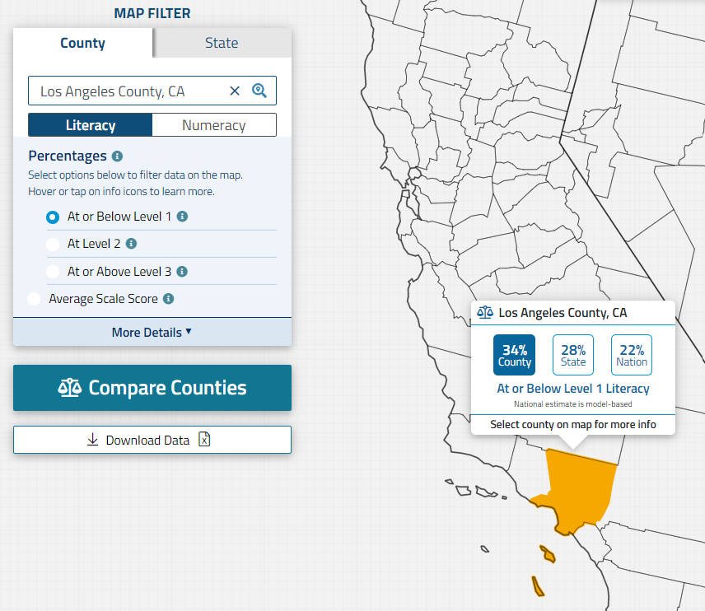
What is the need for adult education in Los Angeles County, CA?
You can either search for your desired county in the text box…
…Or you can hover your cursor over the county on the map, which will display a snapshot of the chosen statistic

Slide 19
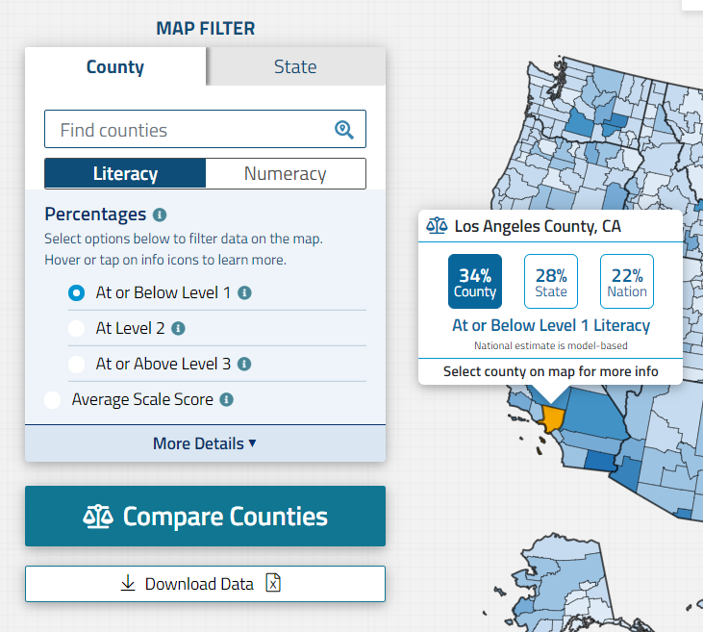
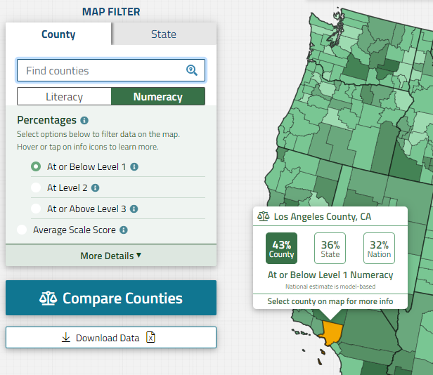
With the filter, you can choose which statistic type is shown.
Additionally, the filter can be used to choose which domain you want to see. Literacy skills are represented in blue and numeracy skills are represented in green

Slide 20
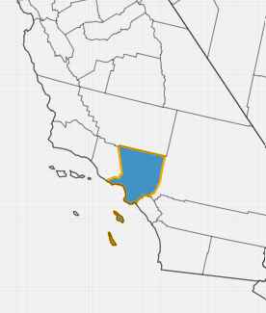
You can double-click on Los Angeles County to see the information on the “county summary card”

Slide 21
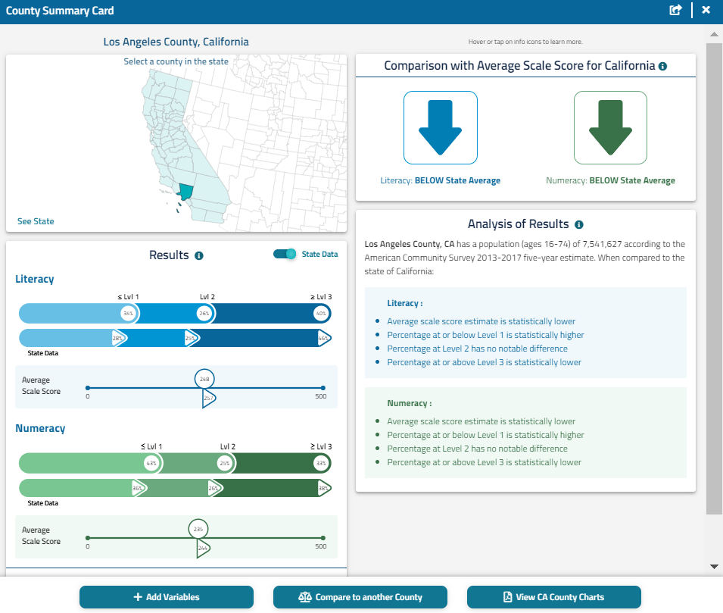
The comparison of Los Angeles County to the California state data is in the box to the right.
To view the California state data, you can click on “see state data.”

Slide 22
For this example, 34% of respondents for Los Angeles County are at or below Level 1 for literacy, while 28% of respondents for the state of California are at or below Level 1. The percentage at or below level 1 in Literacy is statistically higher for Los Angeles County compared to the state.

Slide 23
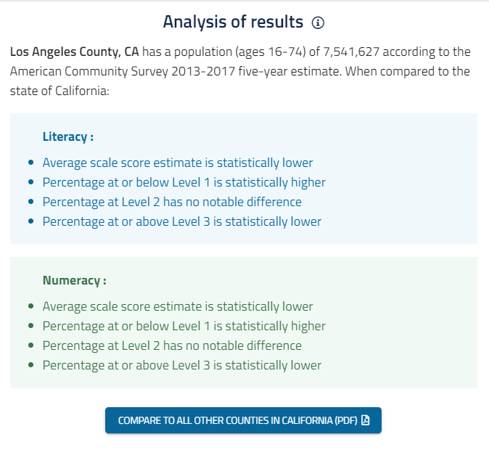
34%
7.5 million
~2.5 million
In order to find out how many adults are at risk, use the number of adult population in Los Angeles County listed on the right panel (7,541,627) and multiply it by the percentage (34%) of adults at or below level 1 in literacy. Results show that 2.5 million adults in Los Angeles County are at or below level 1 in literacy and may benefit from literacy training. Since the percentage is an estimate, it has an upper and lower limit.

Slide 24
31%
7.5 million
~2.3 million
38%
7.5 million
~2.8 million
The upper limit of the percentage at or below level one in literacy is 38% and the lower limit is 31%. If we multiply the population by the upper and lower limit, it gives us a range of adults in Los Angeles County at or below level one in literacy (2.3 – 2.8 million) with the middle being 2.5 million calculated in the previous slide.

Slide 25
How does Los Angeles county compare to Santa Barbara county?
To answer this question:
Compare the percentage of adults in Los Angeles County to Santa Barbara County, who are at or below Level 1 in literacy.

Slide 26
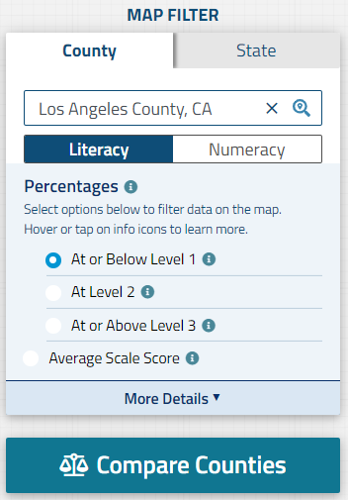
How does Los Angeles county compare to Santa Barbara county?
You can also utilize the PIAAC Skills Map to compare two counties
To compare the scores of two counties against each other, you can select “compare counties”

Slide 27
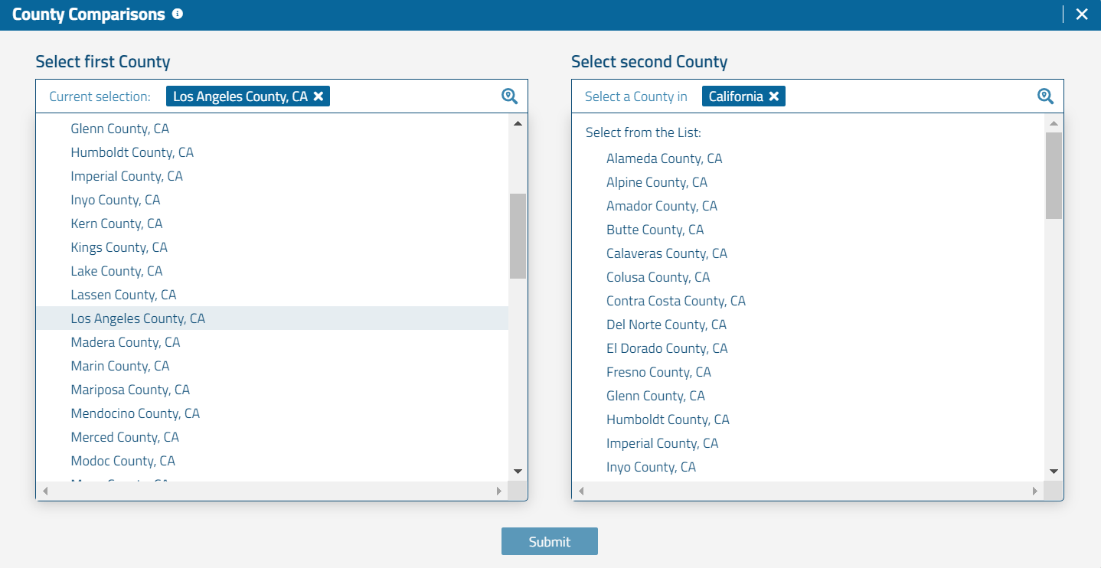
To examine the percentage of adults in need of basic literacy education across Southern California,
select the state(s) of the desired counties, then a list of counties in the state will appear
Select the desired counties, and click the submit button

Slide 28
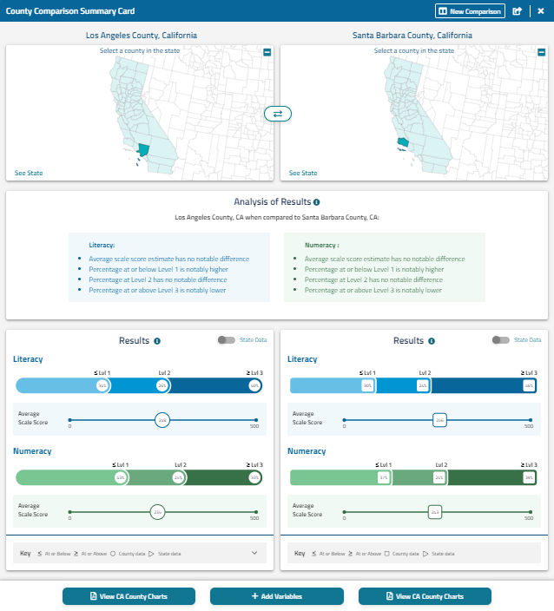
The county reports will appear side-by-side allowing for a clear comparison

Slide 29
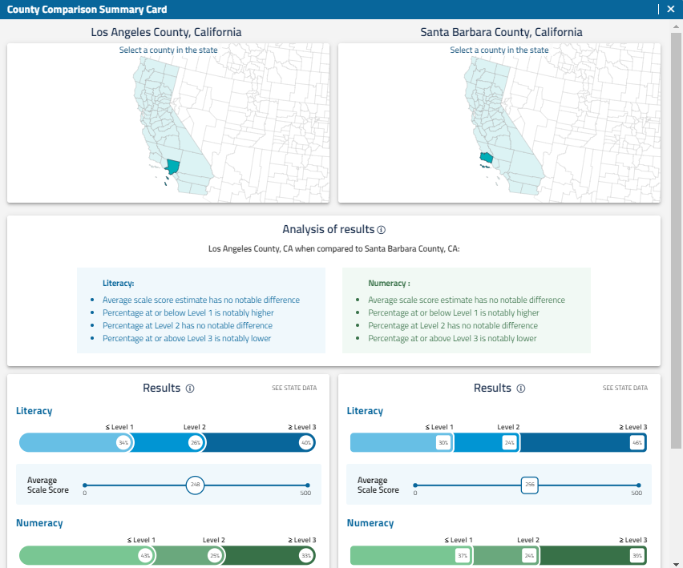
In Los Angeles County, 34% of respondents are at or below level 1 for literacy, while 30% of respondents for Santa Barbara County are at or below level 1. The percentage of respondents at or below level 1 is significantly higher for Los Angeles County than Santa Barbara County. County.

Slide 30
How do Los Angeles County and Santa Barbara County compare in terms of the percentage of adults with less than a high school education?
To answer this question:
Add contextual variables to the comparison of the Los Angeles and Santa Barbara Counties.

Slide 31
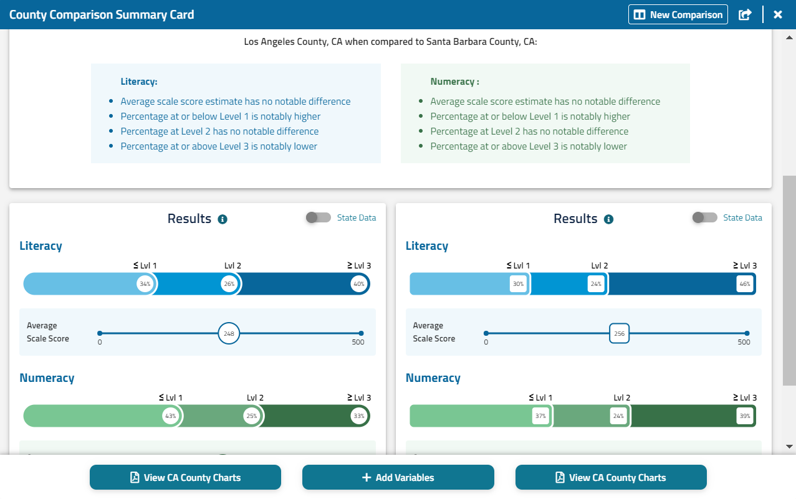
How do Los Angeles County and Santa Barbara County compare in terms of the percentage of adults with less than a high school education?
You can find the answer in the County Comparison Summary Card by clicking on the “ADD VARIABLES” button at the bottom.
Notes:
Users can also select variables from the American Community Survey (ACS), which provide context by presenting basic demographic characteristics for the state or county (e.g. educational attainment, race/ethnicity, employment status, and poverty level).

Slide 32
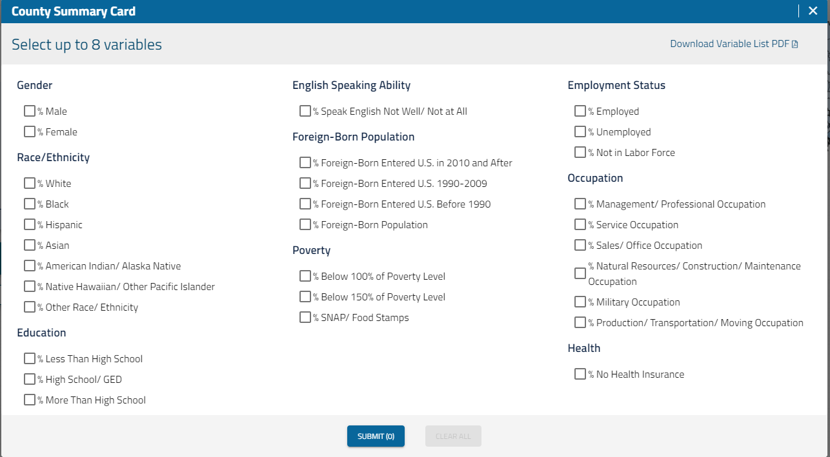
Locate the contextual variable of your choosing. In this example, we want the % Less Than High School variable
When you finish selecting the variable(s), click the “SUBMIT” button.

Slide 33
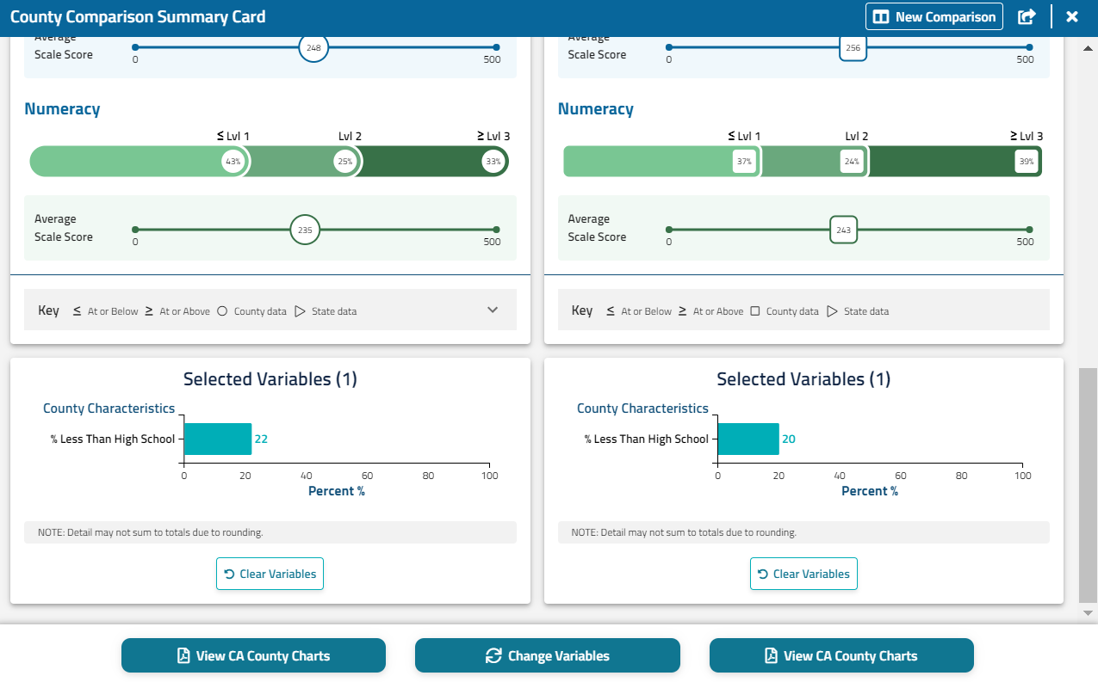
The results for the contextual variables you selected will appear in the bottom of the summary card.
In Los Angeles County, 22% have less than a high school education compared to 20% in Santa Barbara County.
Notes:
The option to use contextual variables is also available when comparing two counties

Slide 34
How do Los Angeles County and Santa Barbara County rank in comparison to other counties in California?
To answer this question:
Access the document with the ranking of all the counties within the state.

Slide 35
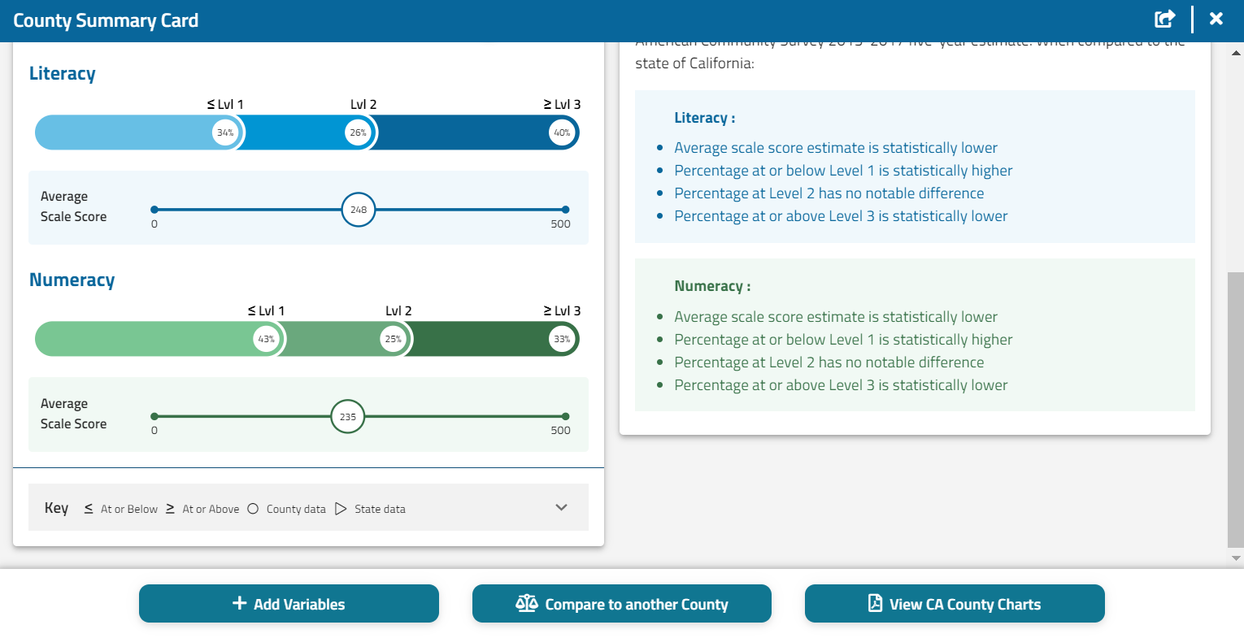
How do Los Angeles County and Santa Barbara County rank in comparison to other counties in California?
Back to the County Summary Card for L.A. County, you can click on the Compare to All Other Counties in State button to download the PDF Comparison Charts of State and County Estimates

Slide 36
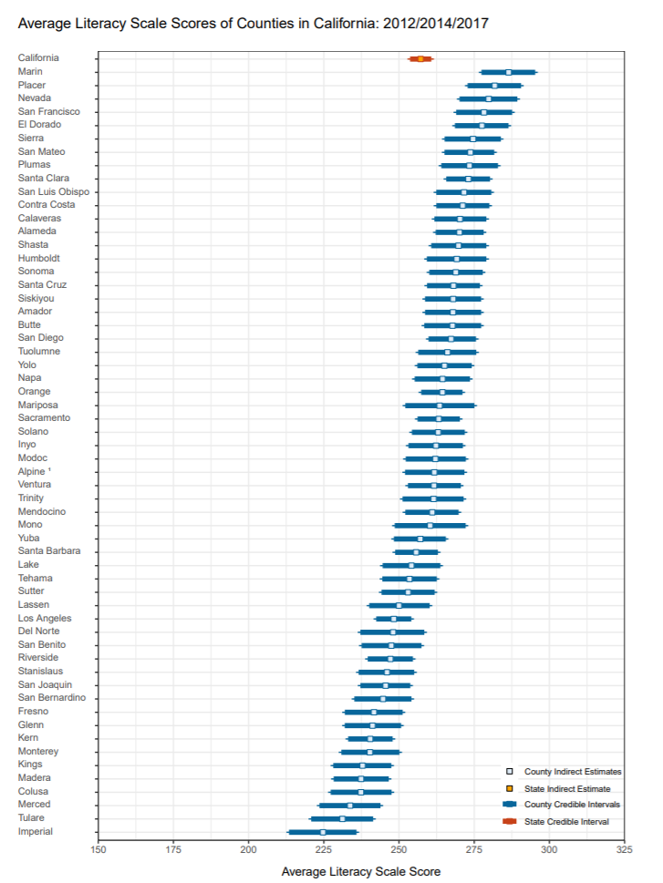
L.A. County and Santa Barbara County fall around the bottom third of counties in California by average literacy score.

Slide 37
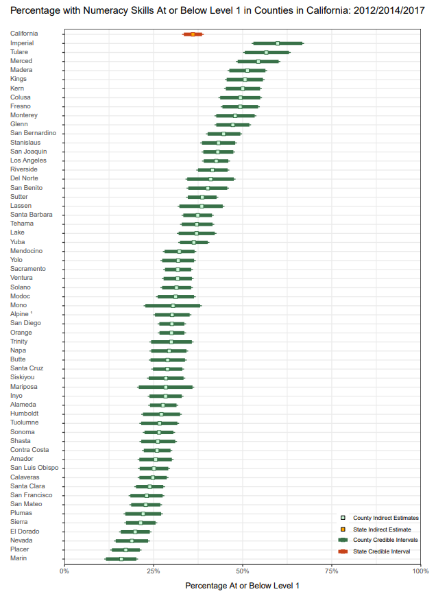
The comparison charts and tables contain average scores and proficiency levels for literacy and numeracy for all counties in the state

Slide 38
How can you download the Skills Map data to answer further questions?

Slide 39
You can access an excel file containing all the data from the Skills Map by clicking on the Download Data button on the page with the full screen map of the United States

Slide 40
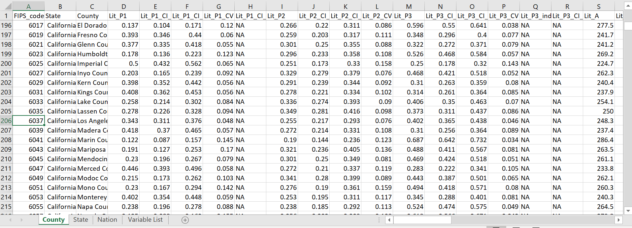
This file contains the skills and background data and can be used for further analysis or if you would like to display the results in different formats
You can use this data to answer other questions about how the skills and demographics of Los Angeles County compare to other countries across the nation.

Slide 41
Resources for further use

Slide 42
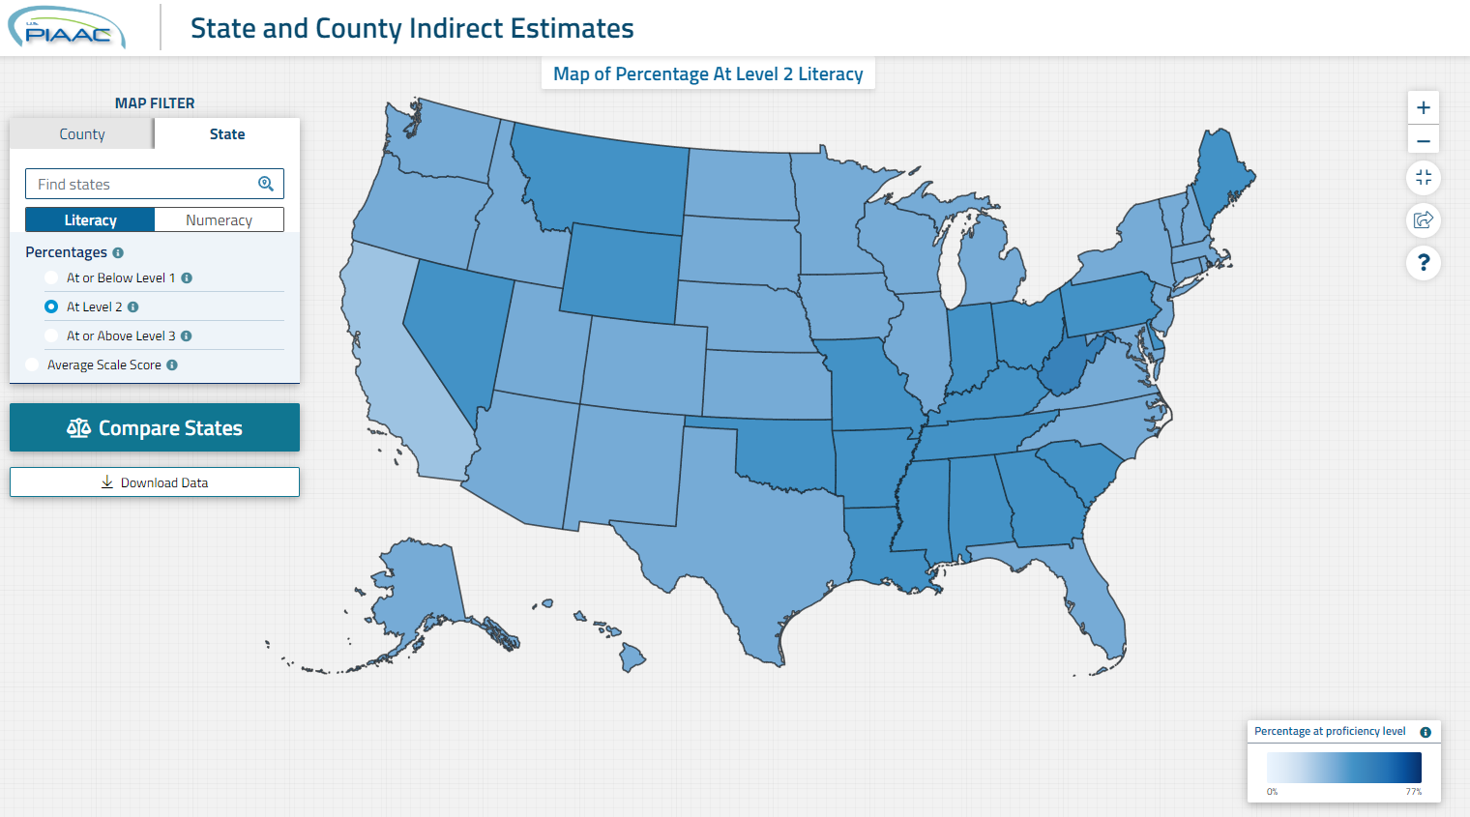
The Skills Map
nces.ed.gov/surveys/piaac/skillsmap

Slide 43
Additional Resources
Visit nces.ed.gov/surveys/piaac/state-county-estimates.asp for more information, including:
Tutorial video for the Skills Map;
Summary of the higher/lower-performing states and counties; and
FAQs.
Visit nces.ed.gov/surveys/piaac/ for information about the PIAAC study.
Contact Holly Xie (Holly.Xie@ed.gov) or Stephen Provasnik (Stephen.Provasnik@ed.gov) with any additional questions.

Slide 44
Additional example questions to answer with the U.S. PIAAC Skills Map can be accessed through this PowerPoint :
Click on the image or visit the Outreach Toolkit page of the PIAAC Gateway to download the Supplemental Examples PowerPoint

