Slide 1
U.S. Low-Skilled Workers:
Focus on Literacy Skills

Slide 2
Guidelines for building your presentation:
Add this slide module to the following slide modules to create the full PIAAC story:
  What is PIAAC
  Results Overview: Focus on Literacy (slides 1-11)
You can also add:
  selections from Sample PIAAC Tasks
  Gateway & Other Resources
  Education & Skills Online (ESO)
  selections from State of the U.S. Workforce: Focus on Literacy Skills

Slide 3
Skill level of U.S. adults

Slide 4
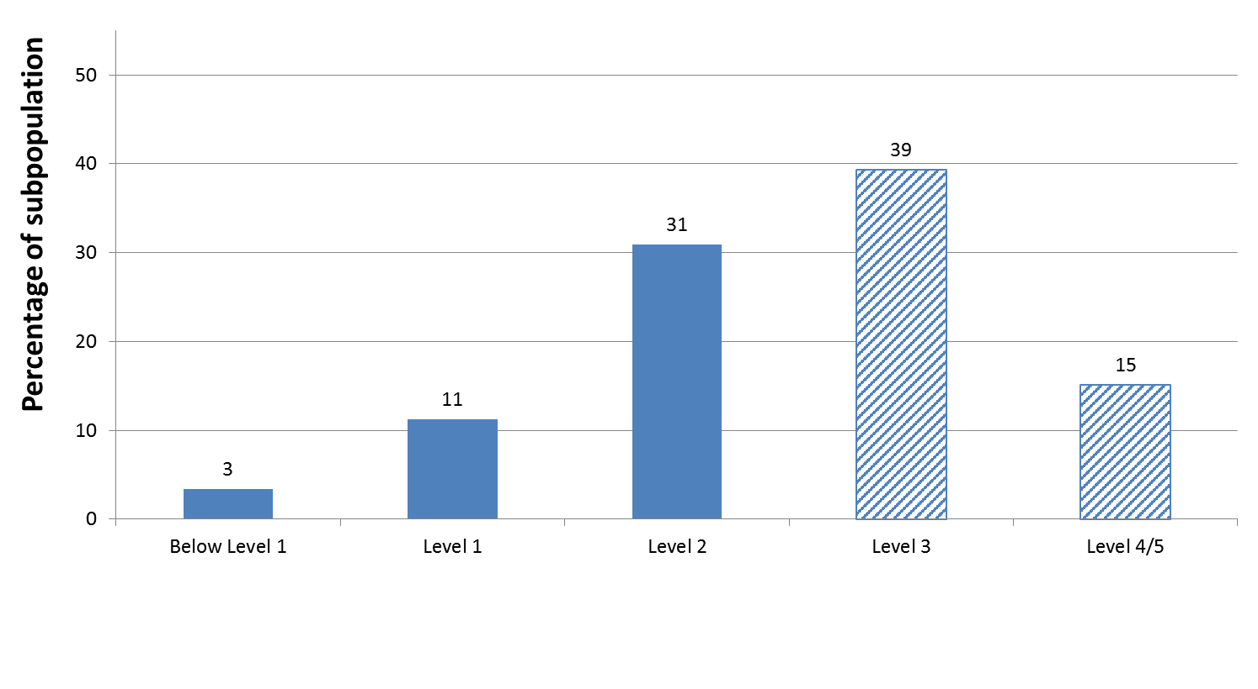
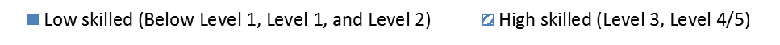
46% of U.S. working adults scored no higher than level 2 in literacy; 15% scored at the two lowest levels.
Note: Detail may not sum to totals because of rounding.
Notes:
No T-Tests were necessary.

Slide 5
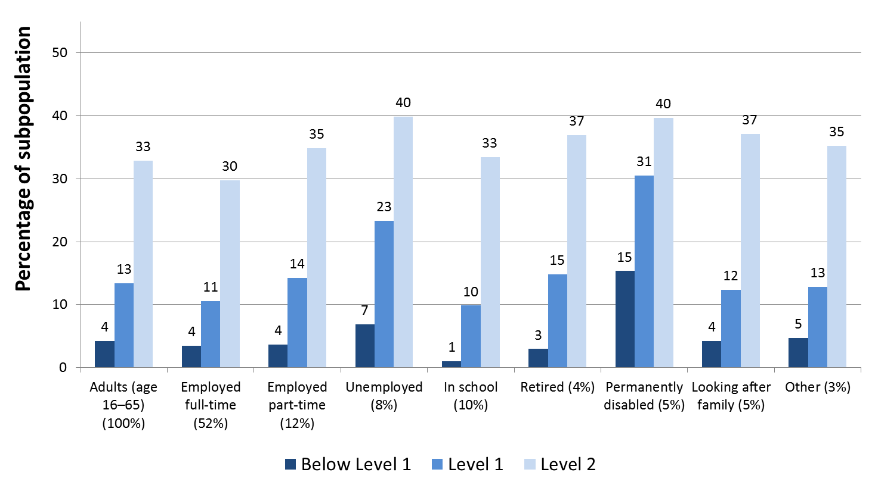
Compared to full-time workers, the percentage with low skills in literacy is greater for part-time workers and the unemployed.
Note: Not all literacy levels or employment categories are shown.
The numbers in the parenthesis show the percentage distribution of the characteristic within the population.
Notes:
T-tests were done on combined Below Level 1, Level 1, and Level 2 estimates for employed full-time vs. employed part-time and employed full-time vs. unemployed.

Slide 6
Why does the skill level of our workforce matter?

Slide 7
Since 1970, there has been a shift in the U.S. economy away from routine and manual tasks and towards more analytic and interpersonal tasks that require higher skills.
Mean task input in percentiles of 1960 distribution
Source: Autor, D. H. and B.M. Price (2013), "The Changing Task Composition of the US Labor Market: An Update of Autor, Levy, and Murnane (2003)", MIT Mimeograph, June.

Slide 8
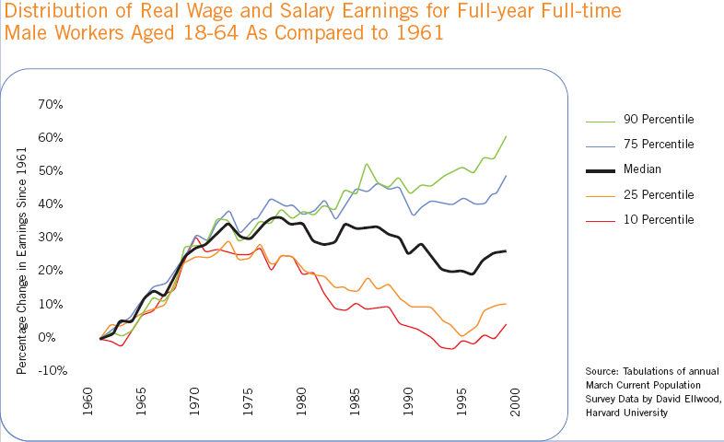
The percentage change in earnings since the 1970s mirrors that shift in occupations.
Percentage Change in Earnings Since 1961
Tabulations of annual March Current Population Survey Data, by David Ellwood, Harvard University.
Tabulations of annual March Current Population Data, by David Ellwood, Harvard University. Slide prepared by ETS.

Slide 9
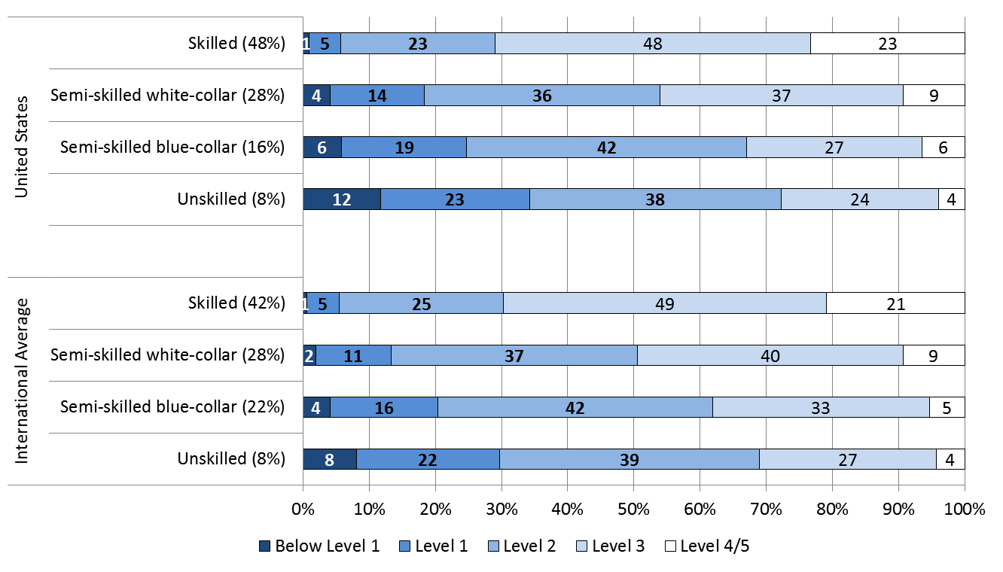
More than a quarter of U.S. adults working in skilled occupations and about half of U.S. adults working in semi-skilled white-collar occupations are low performers in literacy. The trend is similar internationally.
NOTE: The numbers in the parenthesis show the percentage distribution of the characteristic within the population.
Notes:
T-tests were done on combined Below Level 1, Level 1, and Level 2 estimates for skilled workers in the U.S. and internationally vs 25% (a quarter) and semi-skilled white-collar workers in the U.S. and internationally vs 50% (a half).

Slide 10
Where are low-skilled adults in the U.S. working?

Slide 11
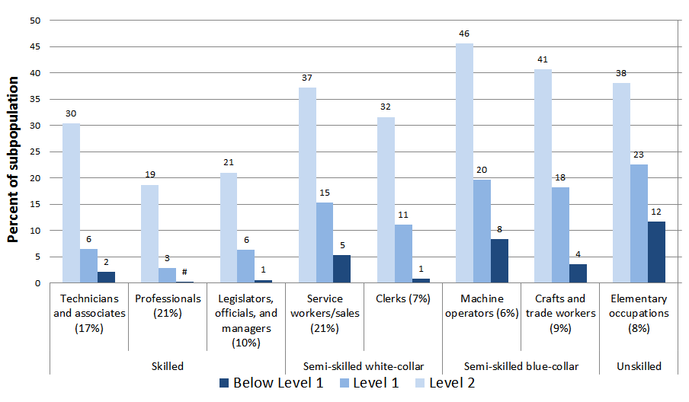
Compared to workers in skilled occupations, a higher percentage of workers in elementary and semi-skilled occupations have low literacy skills.
NOTE: The numbers in the parenthesis show the percentage distribution of the characteristic within the population.
# Rounds to zero.
Notes:
T-tests were done on combined Below Level 1, Level 1, and Level 2 estimates for workers in skilled occupations vs. workers in semi-skilled white-collar occupations; workers in skilled occupations vs. workers in semi-skilled blue-collar occupations; and workers in skilled occupations vs. workers in unskilled occupations.

Slide 12
Higher than average percent of low-skilled adults in literacy worked in construction, administrative, transportation, hospitality & retail industries.
NOTE: The numbers in the parenthesis show the percentage distribution of the characteristic within the population.
Notes:
Industry categories were ranked by percentage of low-skilled population (combined Below Level 1, Level 1, Level 2); ranking is based on the unrounded estimates.
T-tests were done for each industry between the percentage of low-skilled population (combined Below level 1, Level 1, and Level 2) workers vs. average combined estimate for all workers (46%).

Slide 13
How do the skills of U.S. workers differ by gender, age, nativity, and race/ethnicity?

Slide 14
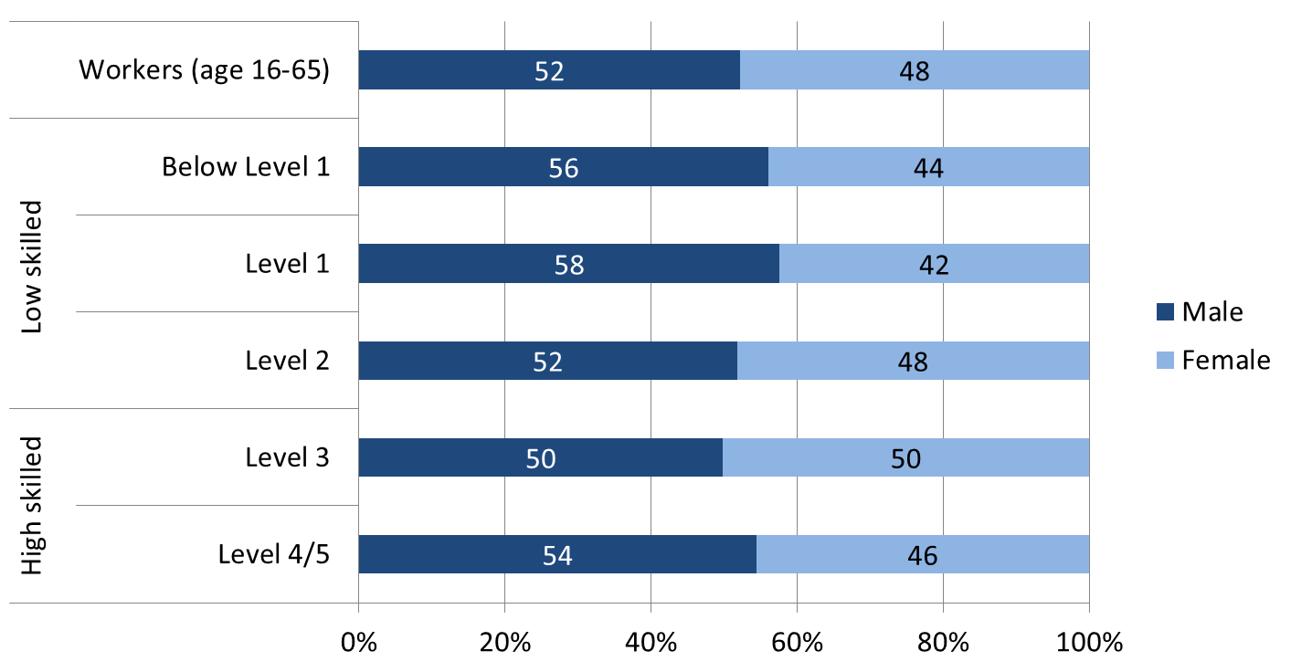
Compared to all workers, there is no significant difference in the percentage of male or female U.S. workers who are low-skilled in literacy.
Notes:
T-tests were done comparing the percentage of males in the total working population vs. the percentage of males in the low-skilled population (combined Below Level 1, Level 1, Level 2) and the percentage of females in the total working population vs. the percentage of females in the low-skilled population (combined Below Level 1, Level 1, Level 2).

Slide 15
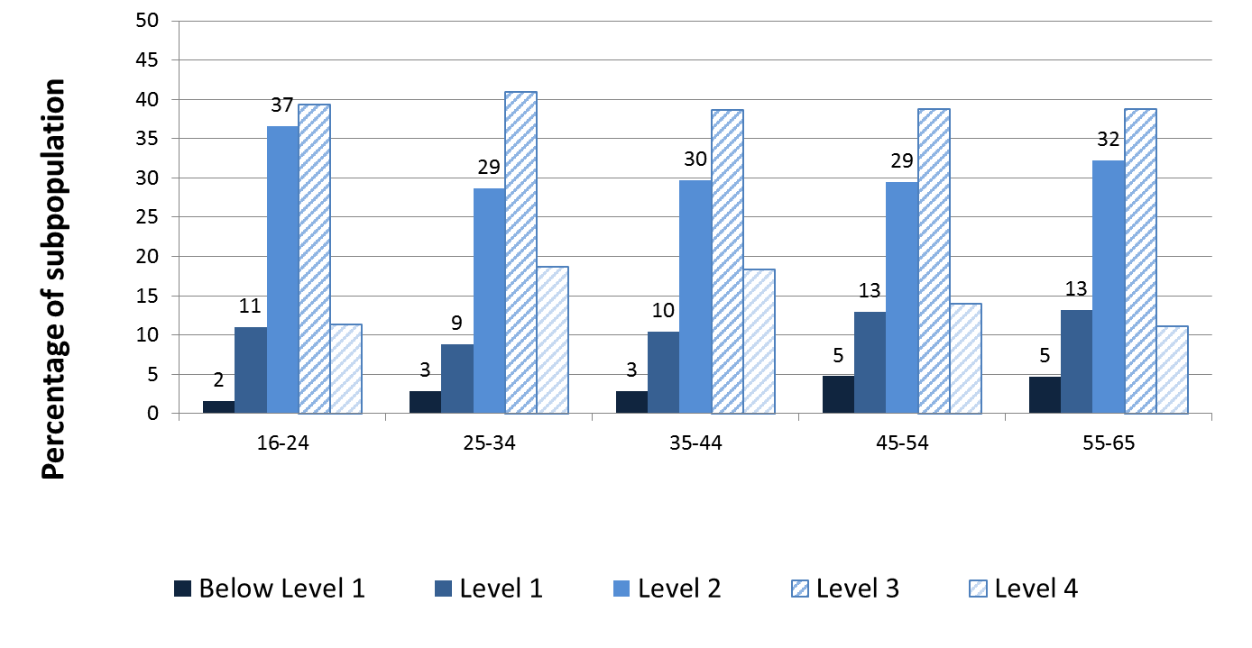
Compared to the other age groups (except 35-44 year olds), those ages 25-34 have the lowest percentage of low-skilled workers in literacy.
Notes:
T-test were done on combined Below Level 1, Level 1, and Level 2 estimates for workers ages 25-34 vs. workers 16-24; workers ages 25-34 vs. workers 35-44; workers ages 25-34 vs. workers 45-54;p and workers ages 25-34 vs. workers 55-65.

Slide 16
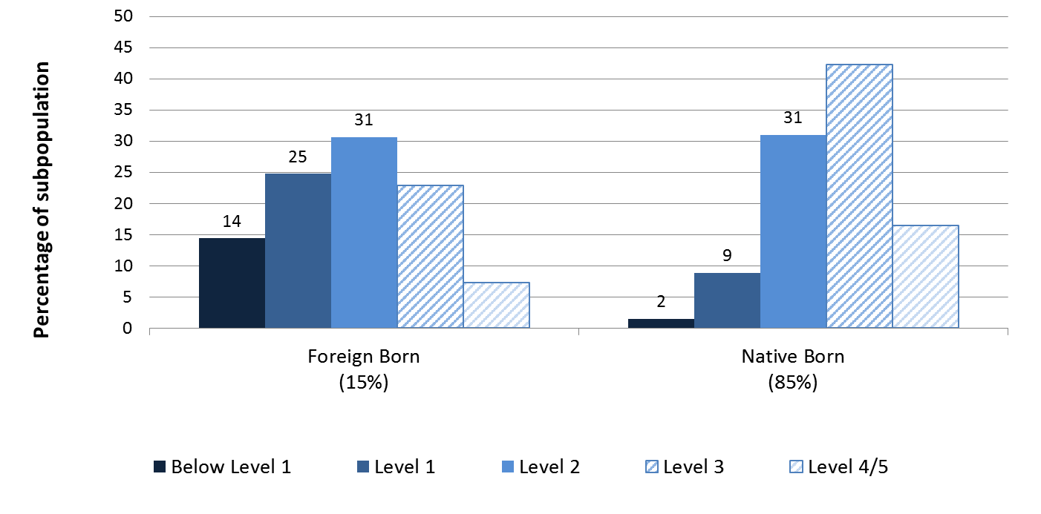
Compared to native-born, a greater percentage of foreign-born U.S. workers are low-skilled in literacy.
Notes:
T-test was done comparing the percentage foreign born in the total working population vs. the percentage foreign born in the low-skilled population (combined Below Level 1, Level 1, Level 2).

Slide 17
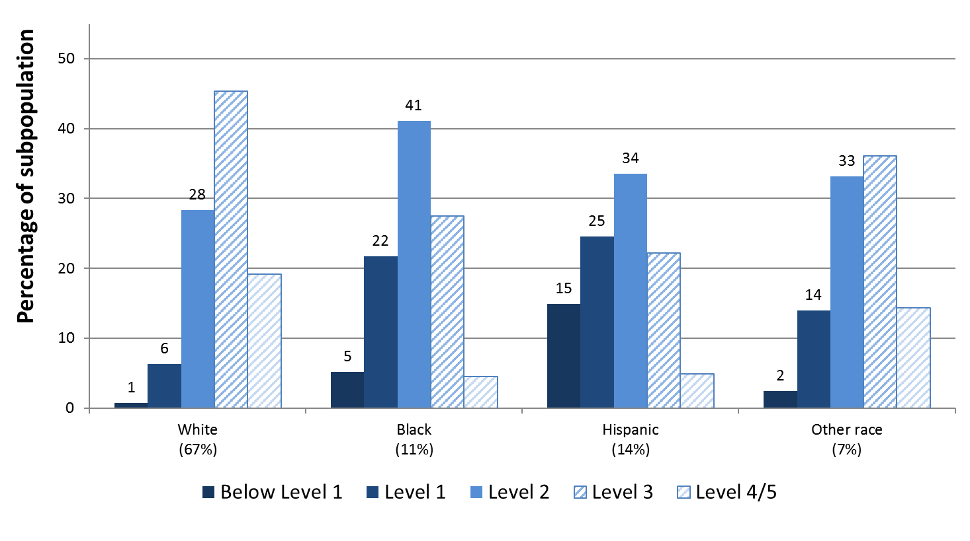
Among U.S. workers, those who are Hispanic, Black and Other race are more likely to be low-skilled in literacy than those who are White.
Notes:
T-test were done on combined Below Level 1, Level 1, and Level 2 estimates for White vs. Black; White vs. Hispanic; and White vs. Other race.

Slide 18
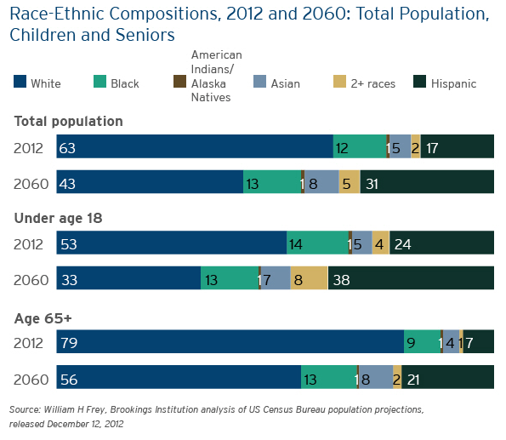
U.S. demographic trend requires targeted policies to promote education and training of racial/ethnic populations with high concentration of low-skilled workers.

Slide 19
How does skill level affect the use of skills at work?

Slide 20
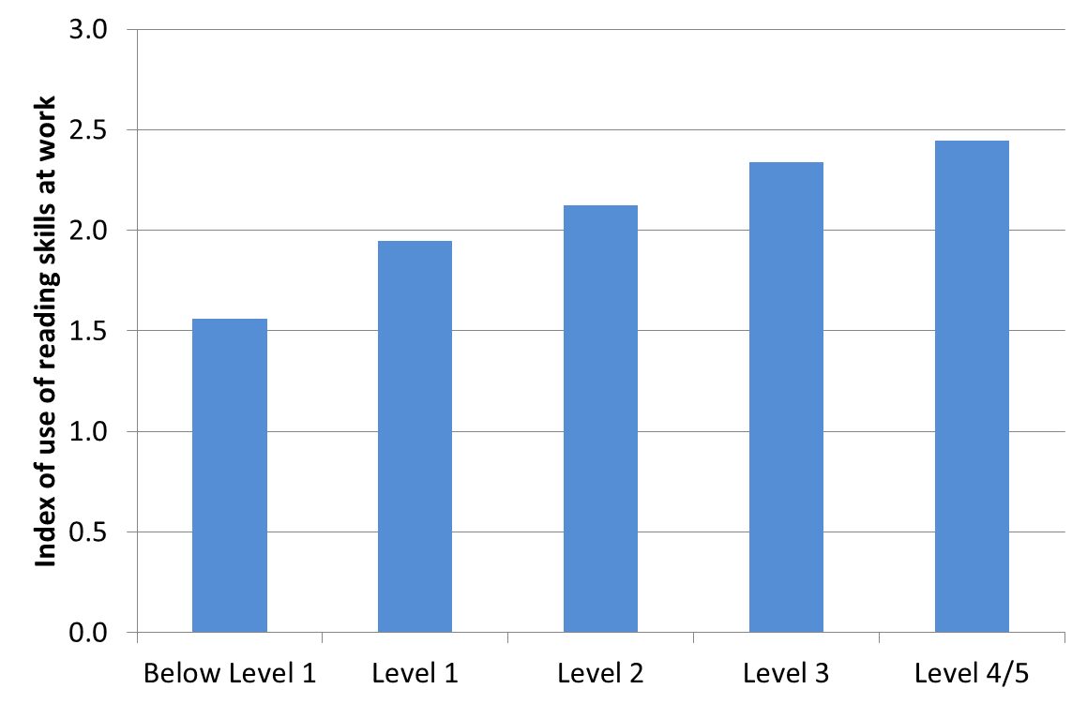
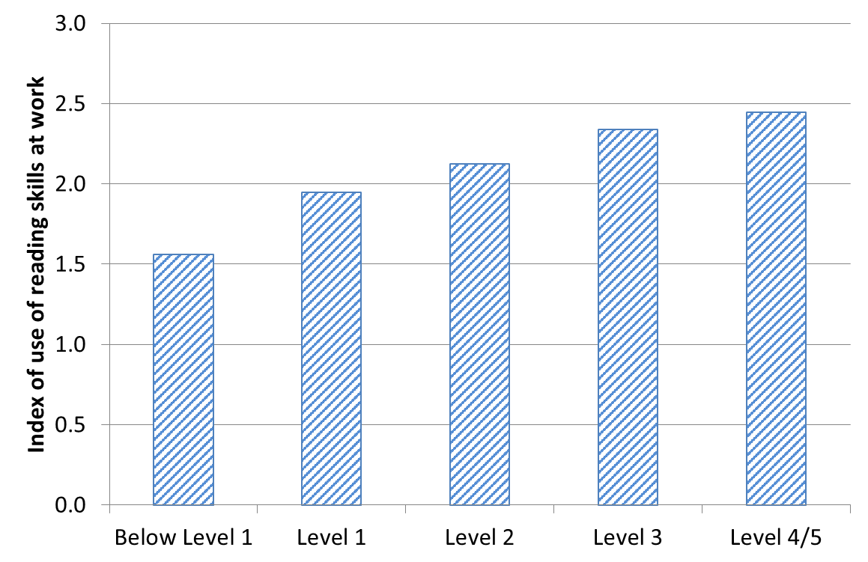
U.S. workers who are low-skilled in literacy use their reading skills at work less frequently than those with high literacy skills.
Notes:
T-tests were done comparing the average reading index for each lower level vs. each higher level, comparing the average for Below Level 1 vs. Level 3; Below Level 1 vs. Level 4/5; Level 1 vs. Level 3; Level 1 vs. Level 4/5; Level 2 vs. Level 3; and Level 2 vs. Level 4/5.

Slide 21
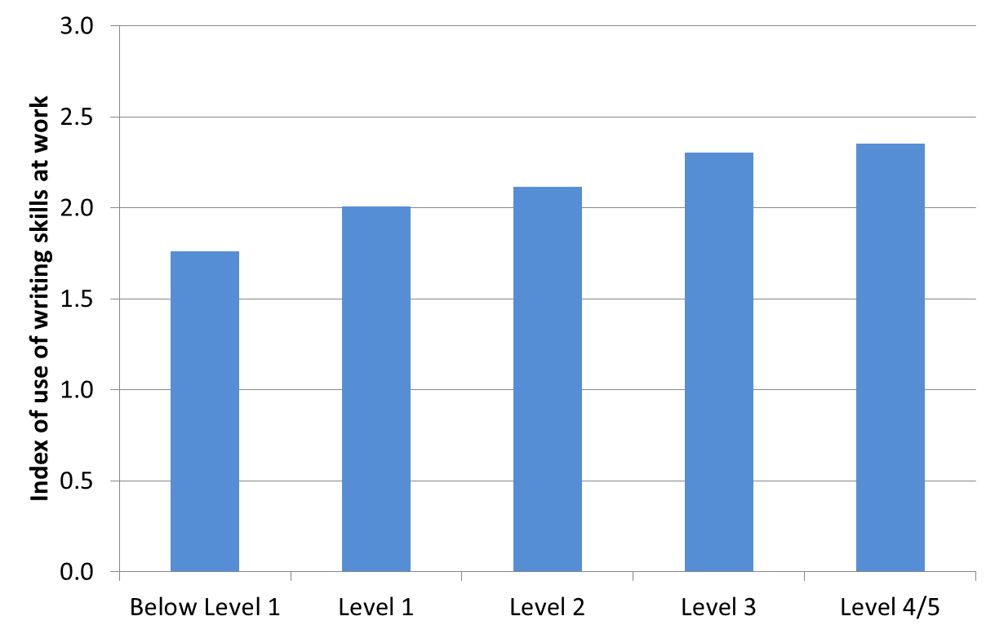
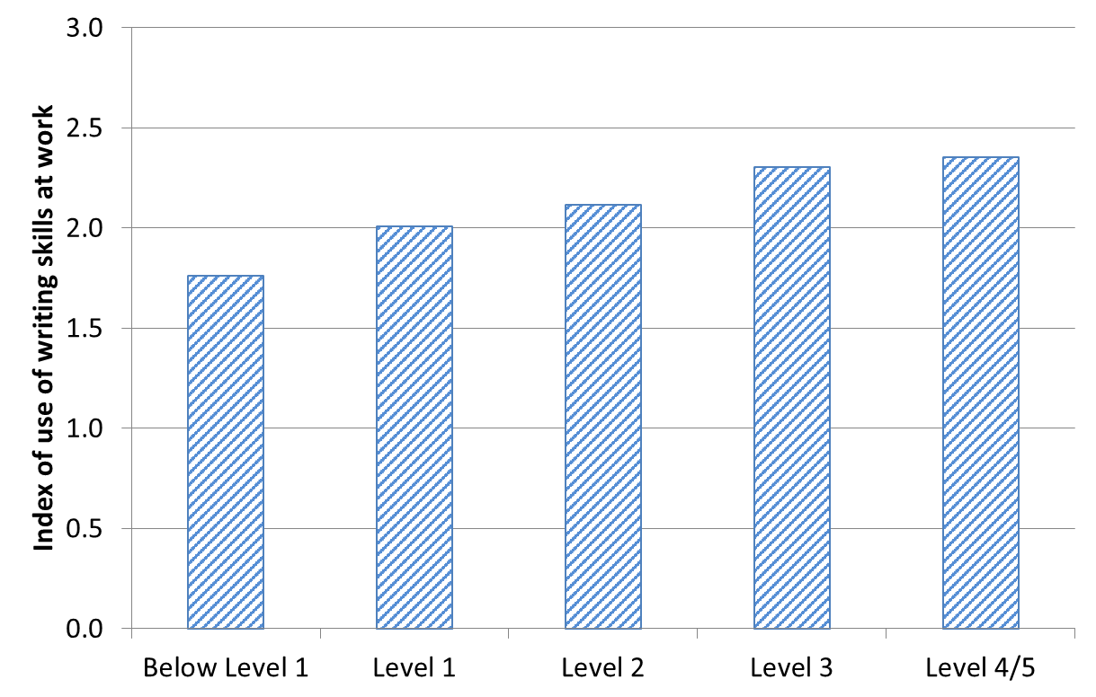
U.S. workers who are low-skilled in literacy also use their writing skills at work less frequently than those with high literacy skills.
Notes:
T-tests were done comparing the average writing index for each lower level vs. each higher level, comparing the average for Below Level 1 vs. Level 3; Below Level 1 vs. Level 4/5; Level 1 vs. Level 3; Level 1 vs. Level 4/5; Level 2 vs. Level 3; and Level 2 vs. Level 4/5.

Slide 22
What is the impact of skill level on income?

Slide 23
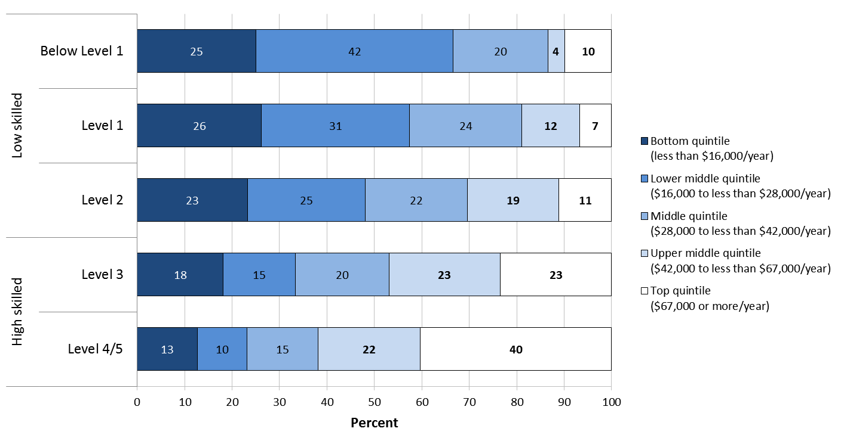
Low-skilled adults in literacy are less likely to have earnings in the upper income quintiles than adults with higher level skills.
Notes:
T-tests were done comparing the percentage in the combined top quintile + upper middle quintile for each lower level vs. each higher level, comparing the percentage for Below Level 1 vs. Level 3; Below Level 1 vs. Level 4/5; Level 1 vs. Level 3; Level 1 vs. Level 4/5; Level 2 vs. Level 3; and Level 2 vs. Level 4/5.

Slide 24
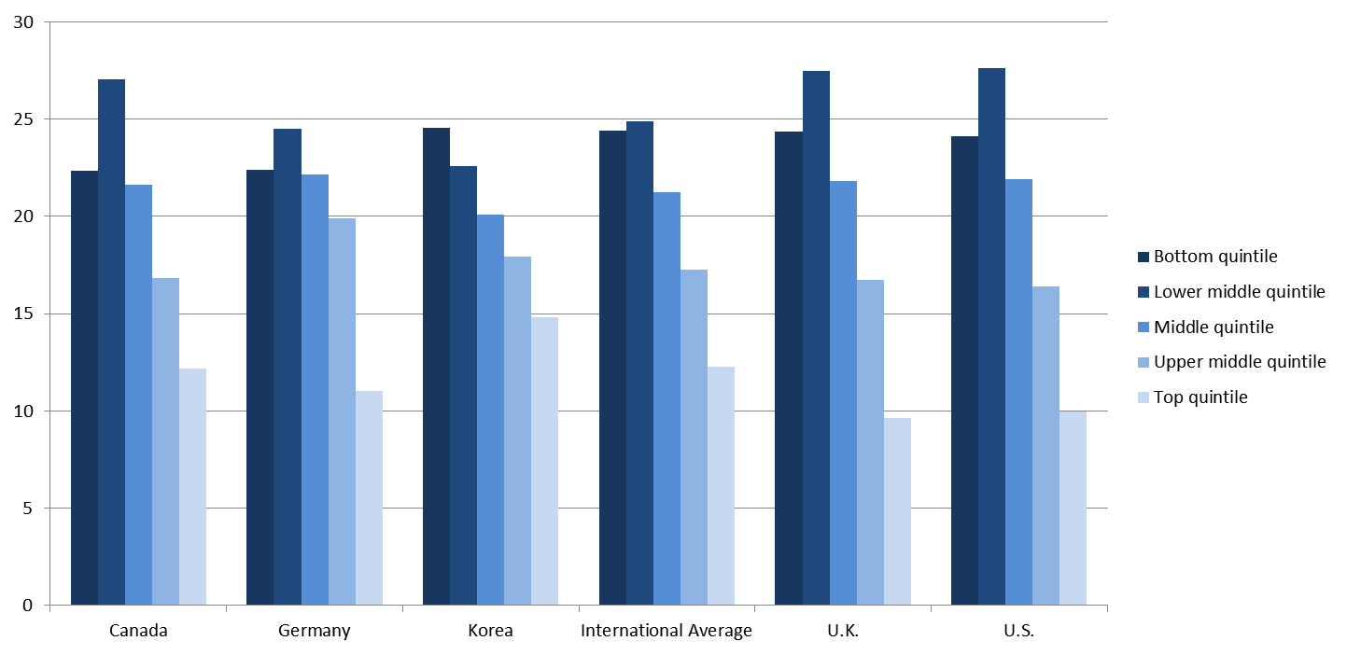
Similar to the international average, about one quarter of low-skilled adults in the U.S. have earnings in the bottom quintile of the income distribution.
Percent of Low-skilled Adults in:
Note: International Average includes Round 1 countries included in the National Center for Education Statistics PIAAC International Data Explorer (NCES PIAAC IDE).
Notes:
T-tests were done comparing the percentage of low-skilled adults (combined Below Level 1, Level 1, Level 2) in the U.S. in the bottom quintile of income to the percentage of low-skilled adults (combined Below Level 1, Level 1, Level 2) in the International Average.
T-tests were also done comparing the percentage of low-skilled adults (combined Below Level 1, Level 1, Level 2) in the U.S. in the bottom quintile of income to the percentage of low-skilled adults (combined Below Level 1, Level 1, Level 2) in each other country displayed here. The percentages in these other countries were not significantly different than in the U.S.
Countries are listed in alphabetical order.

Slide 25
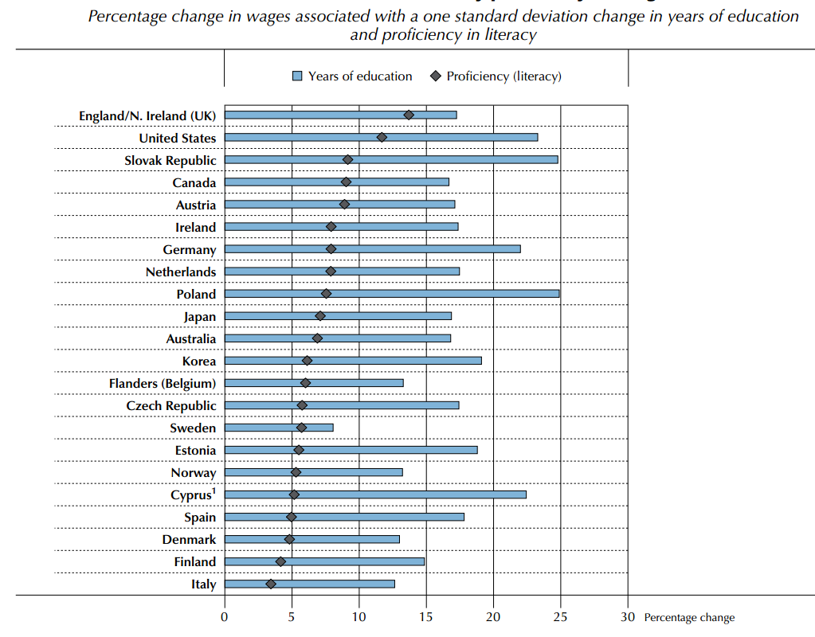
Among countries participating in PIAAC Round 1, the U.S. has one of the highest wage premiums for skills…
DATA SOURCE: Figure 6.7, OECD Skill Outlook 2013, Organization for
Economic Cooperation and
Development (OECD),
Program for the International
Assessment of Adult
Competencies (PIAAC), 2012.
Notes:
Coefficients from the OLS regression of log hourly wages (including bonuses, in PPP-adjusted USD) on years of education and proficiency, directly interpreted as percentage effects on wages. Coefficients adjusted for age, gender, foreign-born status and tenure. The wage distribution was trimmed to eliminate the 1st and 99th percentiles. All values are statistically significant. The regression sample includes only employees. Years of education have a standard deviation of 3.05, literacy has a standard deviation of 45.76.
Countries are ranked in descending order of the effect of proficiency.

Slide 26
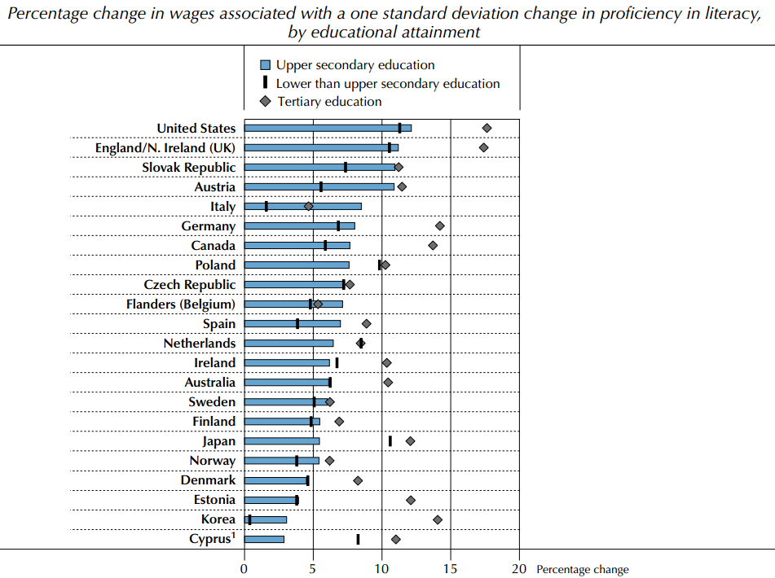
…and one of the highest wage premiums for educational attainment.
DATA SOURCE: Figure 6.8, OECD Skill Outlook 2013, Organization for
Economic Cooperation and
Development (OECD),
Program for the International
Assessment of Adult
Competencies (PIAAC), 2012.
Notes:
Coefficients from the OLS regression of log hourly wages (including bonuses, in PPP-adjusted USD) on proficiency, directly interpreted as percentage effects on wages. Coefficients adjusted for age, gender, foreign-born status and tenure. The wage distribution was trimmed to eliminate the 1st and 99th percentiles. The regression sample includes only employees. Literacy has a standard deviation of 45.76
Countries are ranked in descending order of the effect of literacy proficiency on wages for upper secondary-educated employees.

Slide 27
What can we do to raise the skills of low-skilled workers in the U.S.?

Slide 28
Participation in adult education and training is higher in the U.S. than most countries, but low-skilled adults are less likely to participate than those with high skills.
Add ‘International’ to the Average
Participation rate in adult education, by literacy proficiency levels
Percentage of adults who participated in adult education and training
during year prior to the survey, by level of proficiency in literacy
DATA SOURCE: Figure 5.7, OECD Skill Outlook 2013, Organization for
Economic Cooperation and
Development (OECD),
Program for the International
Assessment of Adult
Competencies (PIAAC), 2012.
Percent
Notes:
Countries are ranked in descending order of the percentage of adults scoring below Level 1 in literacy in adult education and training during year prior to the survey. The participation rate in adult education and training is calculated by excluding students who are considered to still be in their first formal cycle of studies. However, youths aged 16-19 who recently completed or are still in a short duration ISCED 3C or below are considered as adult learners. Similarly, youths aged 20-24 who recently completed or are still in ISCED 3A,B,C or below are considered as adult learners.

Slide 29
What is the relationship between skill level and participation in ongoing formal and non-formal education?

Slide 30
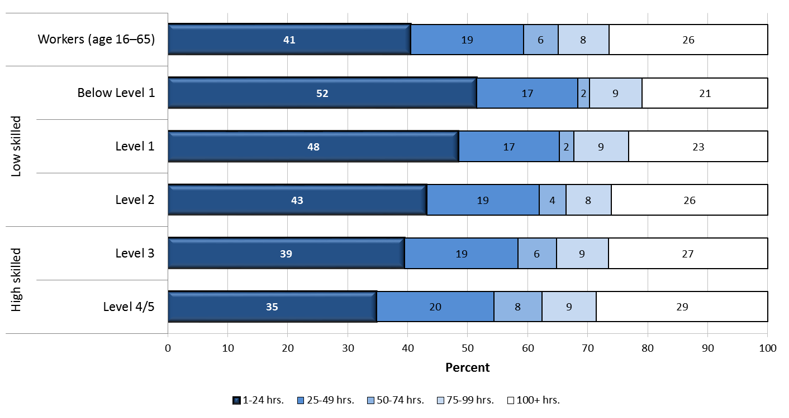
U.S. working adults with low skills in literacy were more likely to participate in less than 25 hours of non-formal education in the past 12 months than those with higher skills in literacy.
Notes:
T-test was done comparing the percentage with 1-24 hours of non-formal education in the low-skilled population (combined Below Level 1, Level 1, Level 2) vs. the percentage in the high-skilled population (combined Level 3, Level 4/5).

Slide 31
What are the constraints and enablers for participation in formal and non-formal education?

Slide 32
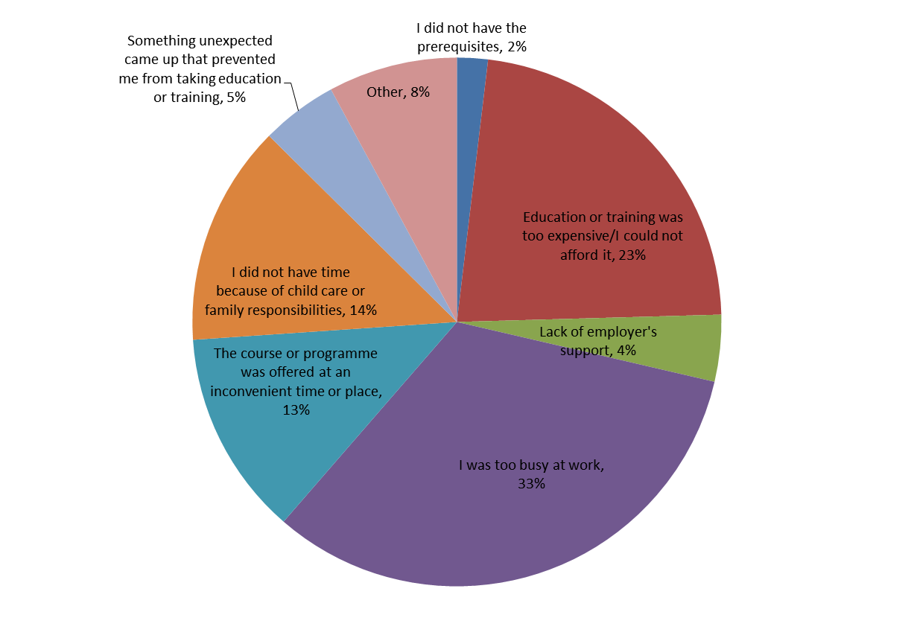
The most common reasons for U.S. working adults not participating in education and training are: too busy at work, cost, family responsibilities including childcare, and time that a course was offered.
Notes:
T-tests were done comparing the percentage for each most common reason (too busy at work, cost, family responsibilities including childcare, and time that a course was offered) vs. each less common reason (other, something unexpected came up, lack of employer’s support, did not have prerequisites) for the population of workers.

Slide 33
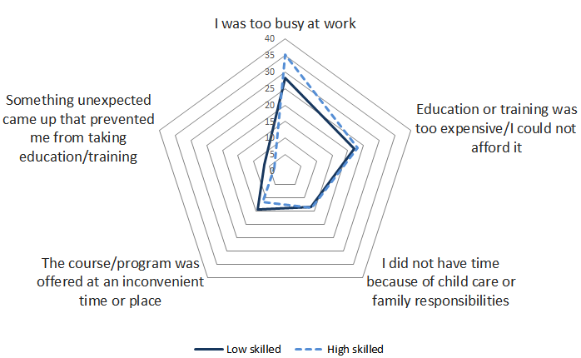
Compared to those with high skills in literacy, low-skilled workers were less likely to state “ too busy at work” as their top reason for not pursuing education and training.
Notes:
T-tests were done comparing the percentage of those who reported each of the reasons for not participating in education and training in the low-skilled population (combined Below Level 1, Level 1, Level 2) vs. the percentage in the combined high-skilled population (combined Level 3, Level 4/5).

Slide 34
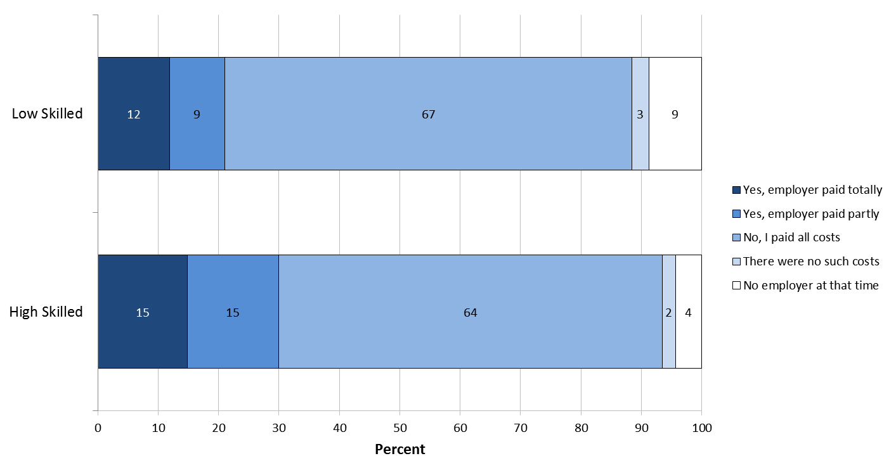
Employers were more likely to pay for expenses related to participation in formal education for workers with high skills in literacy than those with low skills in literacy.
Notes:
T-test was done comparing the percentage whose employers paid expenses (totally + partly paid) in the low-skilled population (combined Below Level 1, Level 1, Level 2) vs. the percentage in the high-skilled population (combined Level 3, Level 4/5).

Slide 35
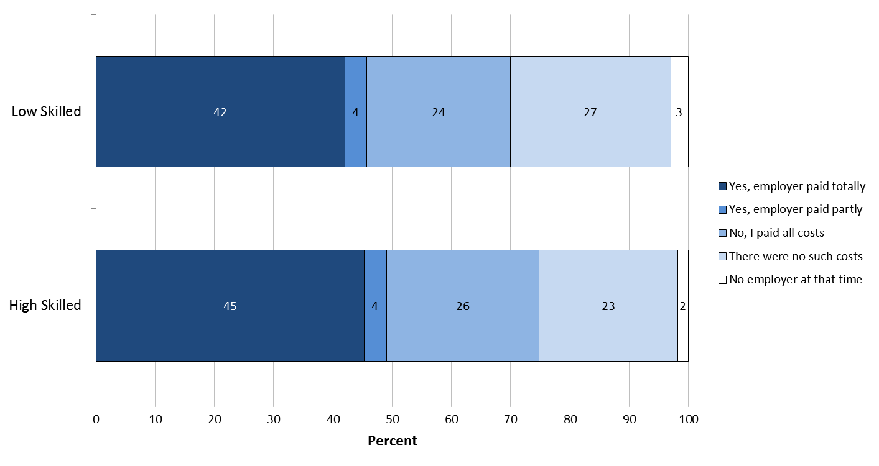
However, there was no measurable difference in how likely employers were to pay non-formal education expenses for workers with high skills than workers with low skills in literacy.
Notes:
T-test was done comparing the percentage whose employers paid expenses (totally + partly paid) in the low-skilled population (combined Below Level 1, Level 1, Level 2) vs. the percentage in the high-skilled population (combined Level 3, Level 4/5).

Slide 36
Modules you can add here:
    Education & Skills Online (ESO)
    Gateway & Other Resources

