Slide 1
Highlights from: Literacy and Numeracy Skills of U.S. Men and Women

Slide 2
Research questions
How do men and women perform on literacy and numeracy assessments?
How do men and women in different age groups differ in their numeracy skills?
How do men and women with different levels of educational attainment differ in their numeracy skills?

Slide 3
How literacy and numeracy are defined in PIAAC
Literacy refers to the “ability to understand, evaluate, use and engage with written texts to participate in society, to achieve one’s goals and to develop one’s knowledge and potential”
Numeracy refers to the “ability to access, use, interpret, and communicate mathematical information and ideas, to engage in and manage mathematical demands of a range of situations in adult life”

Slide 4
How do men and women perform on literacy and numeracy assessments?

Slide 5
Average literacy scores for men and women were similar, but men had higher average numeracy scores than women.
* Significantly different from women (p < .05)

Slide 6
How do men and women in different age groups differ in their numeracy skills?

Slide 7
Men had higher average numeracy scores than women in each age category
* Significantly different from women (p < .05)

Slide 8
How do men and women with different levels of educational attainment differ in their numeracy skills?

Slide 9
Within similar levels of educational attainment, men had higher average numeracy scores than women
* Significantly different from women (p < .05)

Slide 10
Find the source data points and others!
Source for this presentation
Literacy and Numeracy Skills of U.S. Men and Women
Hinz, S. (2018). Literacy and Numeracy Skills of U.S. Men and Women [Data Point]. National Center for Education Statistics, Institute of Education Sciences, U.S. Department of Education. Washington, DC. https://nces.ed.gov/pubs2018/2018164.pdf
Find other data points
Adult Literacy in the United States
Adult Numeracy in the United States (coming soon)

Slide 11
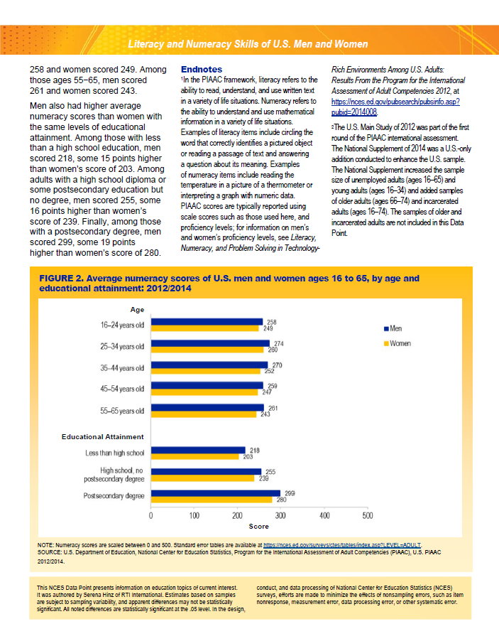
Preview of the data point

