Slide 1
Highlights from: Adult Literacy in the United States

Slide 2
The two parts of the PIAAC study instrument include:
Background Questionnaire (BQ)
Direct Assessment
English OR Spanish
English
Interviewer-administered
Self-administered
Although in the US, the BQ was administered in both English and Spanish, the direct assessment only measures English Literacy.

Slide 3
Definition of Literacy in PIAAC
PIAAC defines literacy as the “…ability to understand, evaluate, use and engage with written texts to participate in society, to achieve one’s goals and to develop one’s knowledge and potential”

Slide 4
English literacy levels were combined into…
Low English Literacy
Could not participate
Below level 1
Level 1
Mid or High English Literacy
Level 2
Level 3
Level 4/5
NOTE: “Could not participate” indicates the respondent could not participate in PIAAC’s background survey either because of a language barrier or a cognitive or physical inability to be interviewed. These adults who were unable to participate are categorized as having low English literacy skills

Slide 5
Mid or High English Literacy (Level 2 and above)...
Mid or High English Literacy
Level 2
Level 3
Level 4/5
Have sufficient skills to complete tasks that require comparing and contrasting information, paraphrasing, or making low-level inferences.

Slide 6
Low English Literacy (Level 1 and below)…
Have difficulty with tasks at higher levels, and those below level 1 are unable to successfully determine the meaning of sentences, read relatively short texts to locate a single piece of information, or complete simple forms.
Low English Literacy
Could not participate
Below level 1
Level 1
NOTE: “Could not participate” indicates the respondent could not participate in PIAAC’s background survey either because of a language barrier or a cognitive or physical inability to be interviewed. These adults who were unable to participate are categorized as having low English literacy skills

Slide 7
What are the rates of English literacy in the United States?

Slide 8
Four in five U.S. adults (79 percent) have mid or high English literacy skills
In contrast, one in five U.S. adults (21 percent) has low English literacy skills

Slide 9
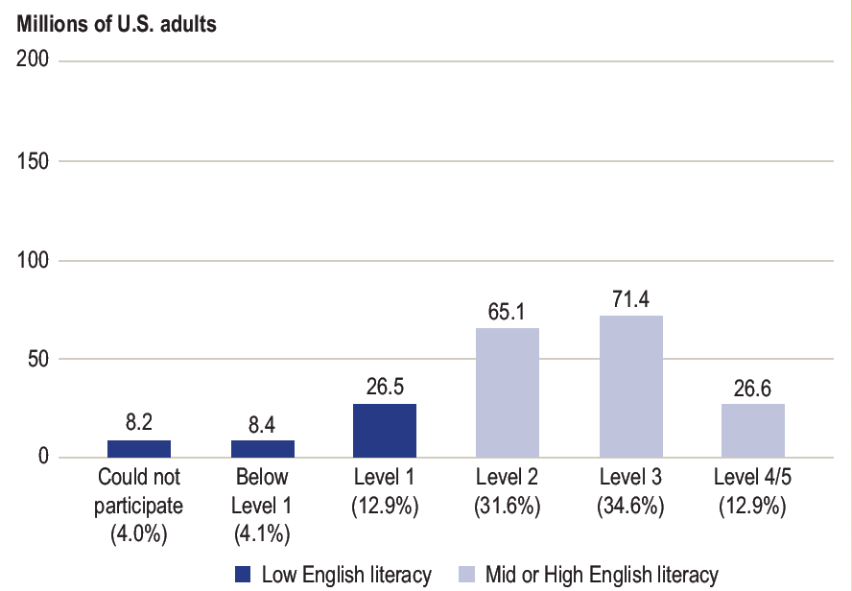
43 million U.S. adults have low English literacy skills
43 million
NOTE: “Could not participate” indicates the respondent could not participate in PIAAC’s background survey either because of a language barrier or a cognitive or physical inability to be interviewed. These adults who were unable to participate are categorized as having low English literacy skills

Slide 10
What is the make-up of adults with low English literacy skills by nativity status and race/ethnicity?

Slide 11
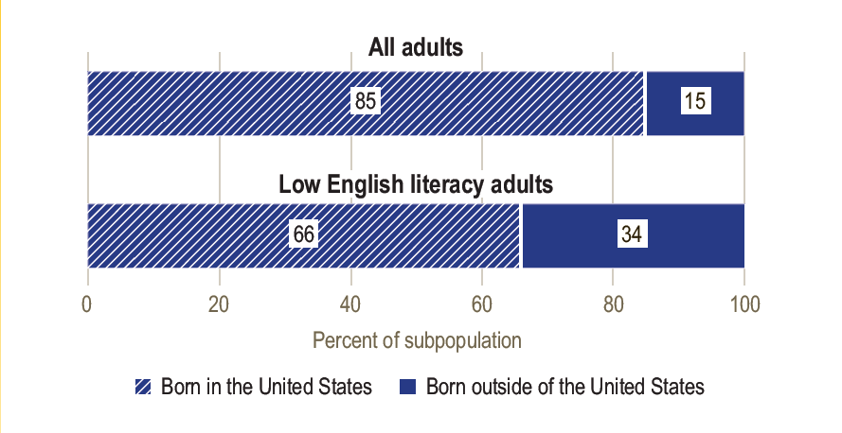
U.S.-born adults make up two-thirds of adults with low levels of English literacy skills in the United States

Slide 12
Non- U.S.-born adults comprise 34 percent of the population with low English literacy skills, compared to 15 percent of the total population

Slide 13
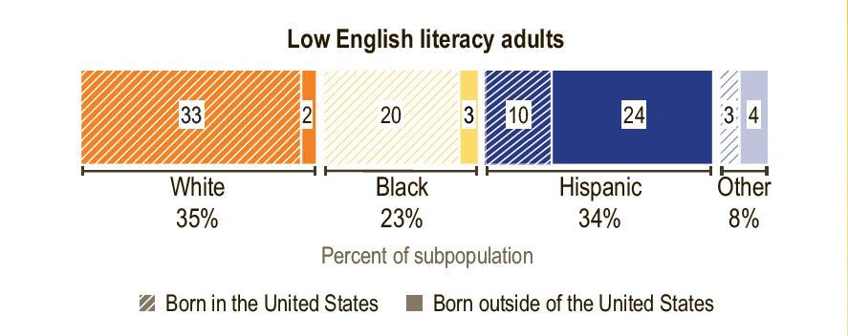
White and Hispanic adults make up the largest percentage of U.S. adults with low levels of English literacy

Slide 14
White U.S.-born adults make up the largest percentage of those with low English literacy skills, followed by Hispanic adults born outside the U.S.

Slide 15
Find the source data points and others!
Source for this presentation:
Adult Literacy in the United States
Mamedova, S. and Pawlowski, E. (2019). Adult Literacy in the United States [Data Point]. National Center for Education Statistics, Institute of Education Sciences, U.S. Department of Education. Washington, DC. https://nces.ed.gov/pubs2019/2019179.pdf.
Find other data points:
Literacy and Numeracy Skills of U.S. Men and Women
Adult Numeracy in the United States (coming soon)

Slide 16
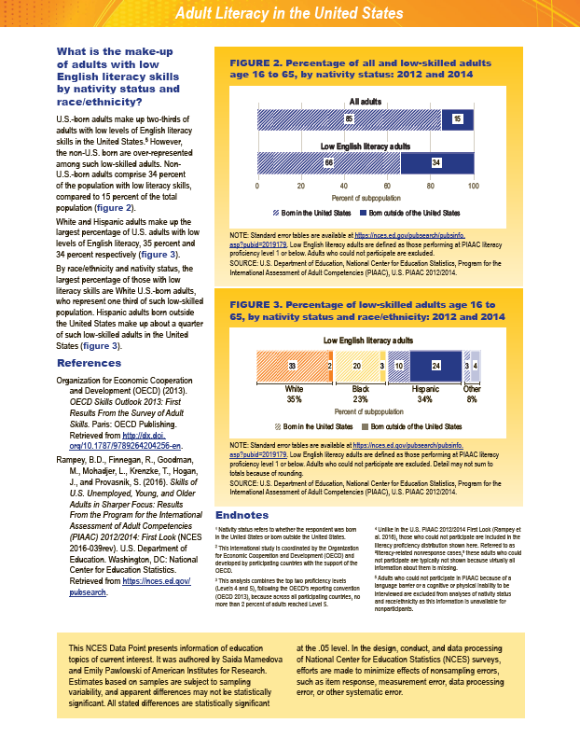
Preview of the data point

