Slide 1
More PIAAC Resources

Slide 2
What else PIAAC can offer:
Education and Skills Online – an online version of PIAAC that will be available in 2015.
Outreach Toolkits so you can share this data with others.
Access to the Data itself, through the NCES or OECD International Data Explorer.
Research reports that analyze the data.
Regular updates through the PIAAC Buzz.
All this, and more, available through the PIAAC Gateway https://piaacgateway.com

Slide 3
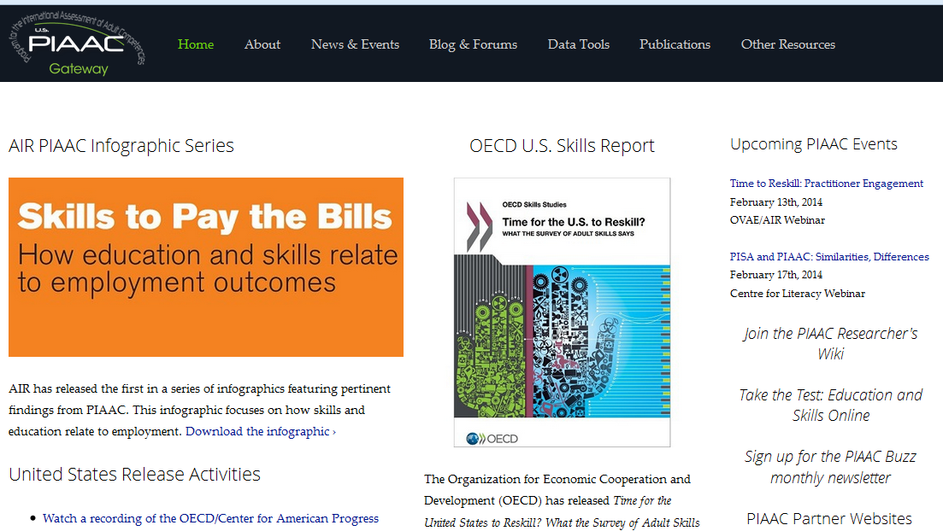
Visit the PIAAC Gateway at:
www.piaacgateway.com

