Slide 1
Sample PIAAC Tasks in Literacy, Numeracy, &
Problem Solving in Technology-Rich Environments

Slide 2
Literacy: Below Level 1 Description
Individuals at this level:
can read brief texts on familiar topics and locate a single piece of specific information identical in form to information in the question or directive.
are not required to understand the structure of sentences or paragraphs and
only basic vocabulary knowledge is required.
Tasks below Level 1 do not make use of any features
specific to digital texts.
From p. 67 of OECD Skills Outlook 2013: First Results from the Survey of Adult Skills

Slide 3
Literacy Item: Below Level 1
SGIH
In this task, respondents are asked to identify a telephone number in a very short advertisement.
The question explicitly refers to literal information in a simple text with little competing information.
The information is prominently located on a single line in the advertisement, labeled by an abbreviation for the word “telephone.”
From p. 5 of ch. 21 of Technical Report of the Survey of Adult Skills (PIAAC)

Slide 4
Literacy: Level 1 Description
At Level 1, adults can:
read relatively short digital or print continuous, non-continuous, or mixed texts to locate a single piece of information, which is identical to or synonymous with the information given in the question or directive.
complete simple forms,
understand basic vocabulary,
determine the meaning of sentences, and
read continuous texts with a degree of fluency.
Texts contain little competing information.
From p. 67 of OECD Skills Outlook 2013: First Results from the Survey of Adult Skills

Slide 5
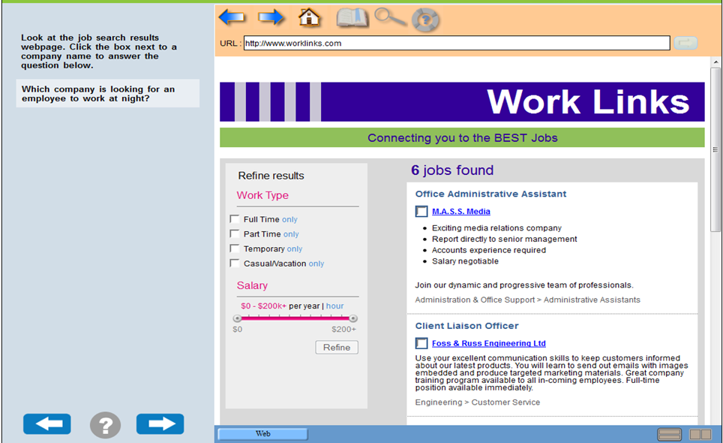
Literacy Item : Level 1
From Education and Skills Online Sample Items

Slide 6
Literacy Item: Level 1
Generic medicine
The stimulus is a short newspaper article entitled “Generic medicines: Not for the Swiss”. It has two paragraphs and a table in the middle displaying the market share of generic medicines in 14 European countries and the United States.
The test-taker is asked to determine the number of countries in which the generic drug market accounts for 10% or more of total drug sales.
The test-taker has to count the number of countries with a market share greater than 10%. The percentages are sorted in descending order to facilitate the search.
The phrase “drug sales”, however, does not appear in the text; therefore, the test-taker needs to understand that “market share” is a synonym of “drug sales” in order to answer the question.
From p. 65 of OECD Skills Outlook 2013: First Results from the Survey of Adult Skills

Slide 7
Literacy Item: Level 1
Dutch women
This task asks the respondent to find the percentage of women in the teaching profession in Greece based on a graphically presented table showing that information for 10 countries.
There is a single instance of the word “Greece” in the stimulus and a single instance of a percentage associated with that word, making the task relatively simple.
There are other percentages in the text that might serve as distractors or cause the respondent to misread the table, which makes this more difficult than the Below Level 1 tasks, but the explicit connection between the question wording and information in the stimulus makes this a relatively simple task.
From p. 6 of ch. 21 of Technical Report of the Survey of Adult Skills (PIAAC)

Slide 8
Literacy: Level 2 Description
At Level 2, adults can:
integrate two or more pieces of information based on criteria,
compare and contrast or reason about information and make low-level inferences.
navigate within digital texts to access and identify information from various parts of a document.
From p. 67 of OECD Skills Outlook 2013: First Results from the Survey of Adult Skills

Slide 9
Literacy Item: Level 2
Lakeside fun run
The stimulus is a simulated website containing information about the annual fun run/walk organized by the Lakeside community club.
The test-taker is first directed to a page with several links, including “Contact Us” and “FAQs”. He or she is then asked to identify the link providing the phone number of the organizers of the event.
In order to answer this item correctly, the test-taker needs to click on the link “Contact Us”.
This requires navigating through a digital text and some understanding of web conventions. While this task might be fairly simple for test‑takers familiar with web-based texts, some respondents less familiar with web-based texts would need to make some inferences to identify the correct link.
From p. 65 of OECD Skills Outlook 2013: First Results from the Survey of Adult Skills

Slide 10
Literacy Item: Level 2
Generic medicines
The stimulus is a short newspaper article entitled “Generic medicines: Not for the Swiss”. It has two paragraphs and a table in the middle displaying the market share of generic medicines in 14 European countries and the United States. (This task uses the same stimulus as that described in Level 1)
The task requires the respondent to use the text of the newspaper article. Here the respondent is asked to identify two reasons given in the text for the limited use of generic medicines. Previous research has shown that tasks requiring multiple responses tend to be more difficult as respondents must search through the text more than once.
While the reasons are explicitly stated in the text, they are not specifically labeled as reasons. Respondents must make an inference based on a semantic cue in the text – the single word “Why?” which signals that reasons will follow. There are other instances of “reasons” in the text (such as why generic medicines are less expensive, signaled by the explicit “because”) that might serve as distractors for less able respondents.
From p. 7 of ch. 21 of Technical Report of the Survey of Adult Skills (PIAAC)

Slide 11
Literacy: Level 3 Description
Adults performing at Level 3 can:
understand and respond appropriately to dense or lengthy texts, including continuous, non-continuous, mixed, or multiple pages.
understand text structures and rhetorical devices and can identify, interpret, or evaluate one or more pieces of information and make appropriate inferences.
perform multistep operations and select relevant data from competing information in order to identify and formulate responses.
From p. 66 of OECD Skills Outlook 2013: First Results from the Survey of Adult Skills

Slide 12
Literacy Item: Level 3
Library search
The stimulus displays results from a bibliographic search from a simulated library website.
The test-taker is asked to identify the name of the author of a book called Ecomyth.
To complete the task, the test-taker has to scroll through a list of bibliographic entries and find the name of the author specified under the book title. In addition to scrolling, the test-taker must be able to access the second page where Ecomyth is located by either clicking the page number (2) or the word “next”.
There is considerable irrelevant information in each entry to this particular task, which adds to the complexity of the task.
From p. 65 of OECD Skills Outlook 2013: First Results from the Survey of Adult Skills

Slide 13
Literacy Item: Level 3
Lakeside Fun Run
This question in the “Lakeside Fun Run” unit asks the respondent to identify information in the Web page that explains how this year’s race differs from last year’s.
Not only does the task require the respondent to understand a contrast – a more difficult semantic construct – but the contrast is only indirectly signaled in the text, which says, “The popular walk will continue, but this year…”
From p. 7 of ch. 21 of Technical Report of the Survey of Adult Skills (PIAAC)

Slide 14
Literacy Item: Level 3
Lakeside Fun Run
A more difficult task from the “Lakeside Fun Run” task requires the respondent to understand a common convention in digital texts – a FAQ (frequently asked questions) link – and be able to use it to navigate through the text.
The respondent is asked to identify the date by which a race participants must notify organizers they want to change their race distances.
In order to find the requested information, the respondent must click on the FAQ link on the home page. Once the respondent has successfully navigated to the FAQ page, the information on the page is relatively easy to find, as there is a near synonymous match between the task statement and the text.
From p. 7-8 of ch. 21 of Technical Report of the Survey of Adult Skills (PIAAC)

Slide 15
Literacy: Level 4 Description
At Level 4, adults can:
perform multiple-step operations to integrate, interpret, or synthesize information from complex or lengthy continuous, non-continuous, mixed, or multiple-type texts that involve conditional and/or competing information.
make complex inferences and appropriately apply background knowledge as well as interpret or evaluate subtle truth claims or arguments.
From p. 66 of OECD Skills Outlook 2013: First Results from the Survey of Adult Skills

Slide 16
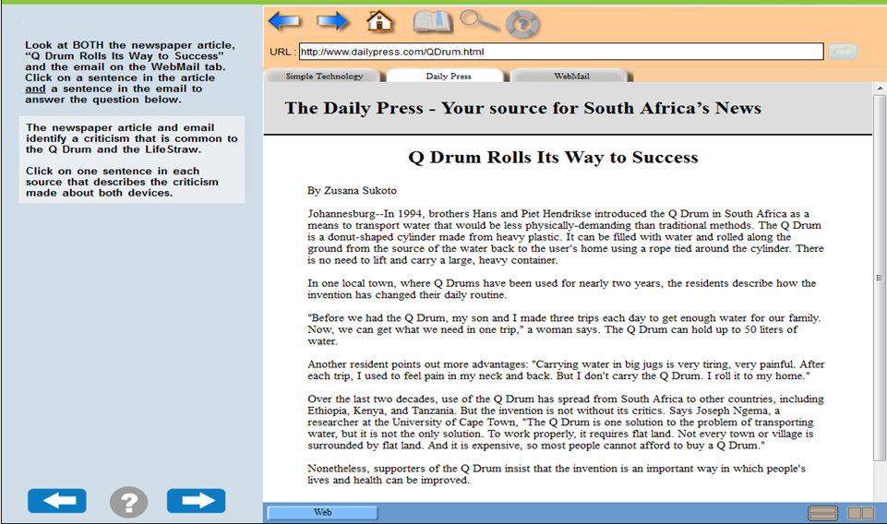
Literacy Item: Level 4
From Education and Skills Online Sample Items

Slide 17
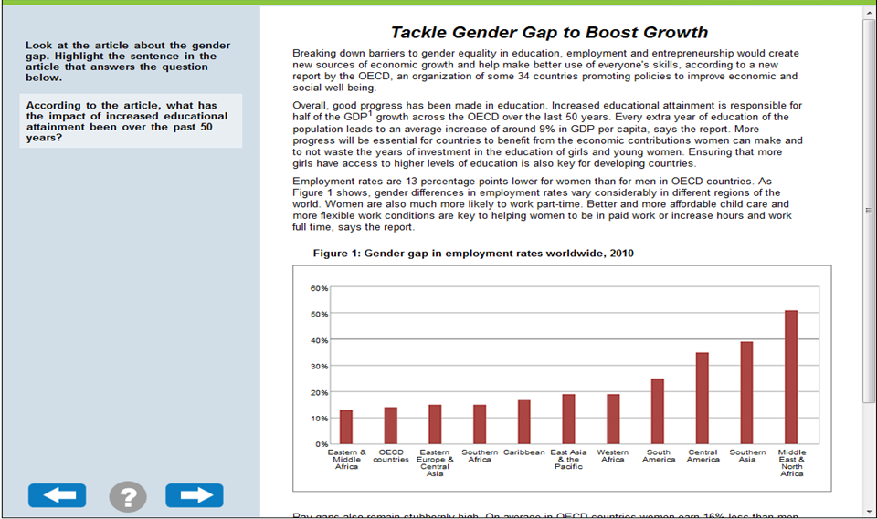
Literacy Item: Level 4
From Education and Skills Online Sample Items

Slide 18
Literacy Item: Level 4
Library search
The stimulus for this unit consists of two pages from a library website listing results for a search on “genetically modified food.”
This task asks the reader to find two books that argue against genetically modified foods, requiring the respondent to examine the brief descriptions of all the books and decide which best meet that criterion.
The respondent must scroll through the full list, using both pages on the website, to make inferences and compare the descriptions in the 10 entries.
As the task asks for two books, the respondent must cycle through the text twice to locate both responses.
From p. 8 of ch. 21 of Technical Report of the Survey of Adult Skills (PIAAC)

Slide 19
Literacy: Level 5 Description
Level 5 is the highest proficiency level on the literacy scale. Adults reaching this level:
can perform tasks that involve searching for and integrating information across multiple, dense texts; constructing syntheses of similar and contrasting ideas or points of view, or evaluating evidence and arguments.
can apply and evaluate logical and conceptual models, and evaluate the reliability of evidentiary sources and select key information.
are aware of subtle, rhetorical cues and are able to make high-level inferences or use specialized background knowledge.
From p. 66 of OECD Skills Outlook 2013: First Results from the Survey of Adult Skills

Slide 20
Literacy Item: Level 5
Library search
One of the most difficult literacy tasks in PIAAC is also associated with the “Library Search” unit.
The respondent is asked to identify the book likely to be least useful in providing more information about genetically modified food.
As mentioned in the framework, negative phasing is more complex than affirmative, so evaluating the 10 books in terms of which is least useful for the defined purpose is expected to be difficult.
The fact that the correct selection is located at the end of the second page of results also increases the difficulty of the task.
The respondent must read and evaluate each of the choices in order to make a correct selection.
From p. 9 of ch. 21 of Technical Report of the Survey of Adult Skills (PIAAC)

Slide 21
Numeracy: Below Level 1 Description
Adults at this level can only cope with very simple tasks set in concrete, familiar contexts where the mathematical content is explicit and that require only simple processes such as:
counting;
sorting;
performing basic arithmetic operations wit whole numbers or money, or
recognizing common spatial representations.
From p. 79 of OECD Skills Outlook 2013: First Results from the Survey of Adult Skills

Slide 22
Numeracy Item: Below Level 1
Price tag
The stimulus for this item consists of four supermarket price tags. These identify the product, the price per kilogram, the net weight, the date packed and the total price.
The test-taker is asked to indicate the item that was packed first by simply comparing the dates on the price tags.
From p. 77 of OECD Skills Outlook 2013: First Results from the Survey of Adult Skills

Slide 23
Numeracy Item: Below Level 1
Bottles
This task requires respondents to look at a photograph containing two cases of water bottles. They are asked to find the total number of bottles in the two full cases being shown. Part of what makes this task easy is that content is drawn from everyday life and objects of this kind are relatively familiar to most people.
What respondents are asked to do is apparent and explicit – this task uses a photograph depicting concrete objects and containing no text to be read.
A third contributing factor is that respondents can approach the task in a variety of ways that differ in sophistication, such as by multiplying rows and columns, but also by simple counting.
This task requires that adults make a conjecture using spatial visualization because the full set of bottles in the lower case is not visible.
From p. 10 of ch. 21 of Technical Report of the Survey of Adult Skills (PIAAC)

Slide 24
Numeracy: Level 1 Description
Adults at Level 1 can:
complete tasks involving basic mathematical processes in common, concrete contexts where the mathematical content is explicit with little text and minimal distractors.
perform one-step or simple processes involving counting, sorting, basic arithmetic operations, understanding simple percents, and locating and identifying elements of simple or common graphical or spatial representations.
From p. 79 of OECD Skills Outlook 2013: First Results from the Survey of Adult Skills

Slide 25
Numeracy Item: Level 1
Candles
The stimulus for this item consists of a photo of a box containing tea light candles. The packaging identifies the product (tea light candles), the number of candles in the box (105 candles) and its weight. While the packaging partially covers the top layer of candles, it can be seen that the candles are packed in five rows of seven candles each.
The instructions inform the test-taker that there are 105 candles in a box and asks him or her to calculate how many layers of tea candles are packed in the box.
From p. 77 of OECD Skills Outlook 2013: First Results from the Survey of Adult Skills

Slide 26
Numeracy: Level 2 Description
Adults at this level:
can successfully perform tasks that require identifying and acting upon mathematical information and ideas embedded in a range of common contexts where the mathematical content is fairly explicit or visual with relatively few distractors.
may require applying two or more steps or processes involving, for example, calculations with whole numbers and common decimals, percents and fractions; simple measurement and spatial representations; estimation; or interpreting relatively simple data and statistics in texts, tables and graphs.
From p. 79 of OECD Skills Outlook 2013: First Results from the Survey of Adult Skills

Slide 27
Numeracy Item: Level 2
From Education and Skills Online Sample Items

Slide 28
Numeracy Item: Level 2
Logbook
The stimulus for this item consists of a page from a motor vehicle logbook with columns for the date of the trip (start and finish), the purpose of the trip, the odometer reading (start and finish), the distance travelled, the date of entry and the driver’s name and signature. For the first date of travel (5 June), the column for the distance travelled is completed.
The instructions inform the test-taker that “a salesman drives his own car and must keep a record of the kilometres he travels in a Motor Vehicle Log. When he travels, his employer pays him €0.35 per kilometre plus €40.00 per day for various costs such as meals”.
The test taker is asked to calculate how much he will be paid for the trip on 5 June. (Note: both units of distance and currency are adapted to reflect the units applying in each participating country.)
From p. 77 of OECD Skills Outlook 2013: First Results from the Survey of Adult Skills

Slide 29
Numeracy Item: Level 2
Gas gauge
A gauge is presented that has three lines or ticks on it: one showing an “F,” one showing an “E” and one in the middle of the others. A line on the gauge, representing the gauge’s needle, shows a level that is roughly halfway between the middle tick and the tick indicating “F,” suggesting that the tank is about three-quarters full.
The task states that the tank holds 48 gallons and asks the respondent to determine “how many gallons remain in the tank.”
This task is drawn from an everyday context and requires an adult to interpret a display that conveys quantitative information but carries virtually no text or numbers. No mathematical information is present other than what is given in the question.
Adults must first estimate the level of gas remaining in the tank by converting the placement of the needle to a fraction. Then they need to determine how many gallons this represents from the 48- gallon capacity stated in the question. Thus, this task requires adults to apply multiple operations or procedures to arrive at a correct response without specifying what the operations may be.
Nonetheless, this task, like many everyday numeracy tasks, does not require an exact computation but allows an approximation that should fall within reasonable boundaries.
From p. 11 of ch. 21 of Technical Report of the Survey of Adult Skills (PIAAC)

Slide 30
Numeracy Item: Level 2
Cooper Test
This item engages the respondent with moderately complex tables of numerical and textual data relating to a common measure of physical fitness – the Cooper Test – from which they have to read off the level of fitness of a 43-year-old male who runs 1,100 meters in 12 minutes.
This task is drawn from everyday life and involves interpreting the headings and numerical information in the table correctly in order to locate the 40-49 age table row and the appropriate cell in this row for a male who runs 1,100 meters in the requisite 12 minutes.
There is no calculation involved, but number bands for both age and distance need to be understood.
From p. 11 of ch. 21 of Technical Report of the Survey of Adult Skills (PIAAC)

Slide 31
Numeracy: Level 3 Description
Adults at Level 3 :
can successfully complete tasks that require an understanding of mathematical information that may be less explicit, embedded in contexts that are not always familiar, and represented in more complex ways.
can perform tasks requiring several steps and that may involve a choice of problem-solving strategies and relevant processes.
have a good sense of number and space; can recognize and work with mathematical relationships, patterns, and proportions expressed in verbal or numerical form; and
can interpret and perform basic analyses of data and statistics in texts, tables and graphs.
From p. 78 of OECD Skills Outlook 2013: First Results from the Survey of Adult Skills

Slide 32
Numeracy Item: Level 3
From Education and Skills Online Sample Items

Slide 33
Numeracy Item: Level 3
Package
The stimulus for this item consists of an illustration of a box constructed from folded cardboard. The dimensions of the cardboard base are identified.
The test-taker is asked to identify which plan best represents the assembled box out of four plans presented in the stimulus.
From p. 77 of OECD Skills Outlook 2013: First Results from the Survey of Adult Skills

Slide 34
Numeracy Item: Level 3
Tiles
This item presents the respondent with a plan of a kitchen floor to be tiled with nine of the proposed square tiles placed in a corner, with the plan drawn on a squared grid.
It asks the respondent to use this information to find out how many tiles are needed to cover the entire floor.
The task is a familiar one drawn from everyday life and, using the most obvious method an adult would choose, would require several operations to arrive at the correct answer.
First, the area in terms of the number of larger grid squares in the kitchen floor plan is calculated by counting or otherwise. Then the number of tiles in each larger square is calculated by counting or multiplication. The last step involves multiplying the number of larger squares by the number of tiles per larger square to get the total number of tiles required to cover the kitchen floor.
Respondents need to use their spatial reasoning ability in organizing the information in the first two steps in this task. The task could also be done using a combination of spatial visualization and counting all the small squares (tiles), but this method would be more prone to error.
From p. 12 of ch. 21 of Technical Report of the Survey of Adult Skills (PIAAC)

Slide 35
Numeracy Item: Level 3
Orchestra tickets
This task presents the respondent with a table of numerical data on ticket price categories for single and multiple events (Season Ticket).
The respondent has to discern the pattern in the data and identify the formula, probably in verbal or numerical terms (e.g., multiply by 4½), for calculating the cost of a season ticket from the cost of a single ticket for different seating categories to an event, and use it to calculate the cost of a season ticket for a new entry category – a student season ticket.
The task requires adults to use a range of reasoning strategies, including algebraic reasoning (i.e., reasoning with variables and generalizing from specific values) and computational procedures.
From p. 12 of ch. 21 of Technical Report of the Survey of Adult Skills (PIAAC)

Slide 36
Numeracy: Level 4 Description
At this level, adults:
understand a broad range of mathematical information that may be complex, abstract or embedded in unfamiliar contexts.
can perform tasks involving multiple steps and select appropriate problem-solving strategies and processes.
can analyze and engage in more complex reasoning about quantities and data, statistics and chance, spatial relationships, change, proportions and formulae.
can also understand arguments and communicate well reasoned explanations for answers or choices.
From p. 78 of OECD Skills Outlook 2013: First Results from the Survey of Adult Skills

Slide 37
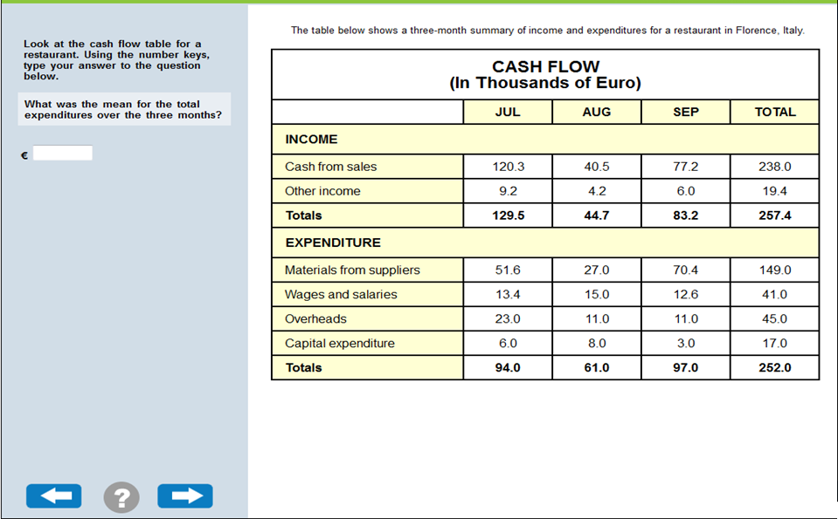
Numeracy Item: Level 4
From Education and Skills Online Sample Items

Slide 38
Numeracy Item: Level 4
Education level
The stimulus for this item consists of two stacked-column bar graphs presenting the distribution of the Mexican population by years of schooling for men and women separately.
The y axis of each of the graphs is labelled “percentage” with 6 grid lines labelled “0%”, “20%”, “40%”, “60%”, “80%” and “100%”. The x axis is labelled “year” and data are presented for 1960, 1970, 1990, 2000 and 2005. A legend identifies three categories of schooling: “more than 6 years of schooling”, “up to 6 years of schooling” and “no schooling”.
The test-taker is asked to approximate what percentage of men in Mexico had more than 6 years of schooling in 1970, choosing from a pull-down menu that has 10 response categories: “0-10%”, “10-20%”, and so on.
From p. 78 of OECD Skills Outlook 2013: First Results from the Survey of Adult Skills

Slide 39
Numeracy Item: Level 4
Cooper test
This task is based on the same stimulus as the Level 2 task described above.
It requires respondents to go beyond interpreting the information in the tables to calculate the percent increase needed in the distance run by a female in 12 minutes for her fitness level to be in the “Good” category.
To arrive at a correct response, respondents have to locate the “Good” band for a 27-year-old female and use the difference between the runner’s current 12-minute distance and the minimum distance for the “Good” band to calculate the percent increase in distance run by her to qualify for that band.
There is considerable use of reasoning and knowledge and understanding of percentages in carrying out this task.
From p. 13 of ch. 21 of Technical Report of the Survey of Adult Skills (PIAAC)

Slide 40
Numeracy Item: Level 4
Compound Interest
This task presents respondents with an advertisement claiming it is possible for an investor to double an amount invested in seven years, based on a 10 percent fixed interest rate each year.
Adults are asked if it is possible to double $1,000 invested at this rate after seven years and have to support their answer with their calculations.
A range of responses was accepted as correct as long as a reasonable justification was provided, with relevant computations.
Respondents were free to perform the calculation any way they wanted, but they could use a “financial hint,” which accompanied the advertisement and presented a formula for estimating the worth of an investment after a specified number of years. Those who used the formula had to enter information stated in the text into variables in the formula (principal, interest rate and time period) and then perform the needed computations and compare the result to the expected amount if $1,000 is doubled. All respondents could use a handheld calculator provided as part of the assessment.
This task proved difficult because it involved percents, and the computation, with or without the formula, required the integration of several steps and several types of operations. Performing the computations without the formula required understanding of compound interest procedures.
This task required adults to use a range of reasoning strategies, including algebraic reasoning and informal or invented procedures. It also required the use of formal mathematical information and deeper understanding of nonroutine computational procedures, all of which may not be familiar or accessible to many adults.
From p. 13 of ch. 21 of Technical Report of the Survey of Adult Skills (PIAAC)

Slide 41
Numeracy: Level 5 Description
Adults at Level 5 on the numeracy scale can:
understand complex representations, and abstract and formal mathematical and statistical ideas, sometimes embedded in complex texts.
integrate several types of mathematical information where considerable translation or interpretation is required; draw inferences;
develop or work with mathematical arguments or models; and
justify, evaluate and critically reflect upon solutions or choices.
From p. 78 of OECD Skills Outlook 2013: First Results from the Survey of Adult Skills

Slide 42
Problem Solving: Below Level 1 Description
Below Level 1, adults can:
complete tasks in which the goal is explicitly stated and for which the necessary operations are performed in a single and familiar environment.
solve problems whose solutions involve a relatively small number of steps, the use of a restricted range of operators, and a limited amount of monitoring across a large number of actions.
From p. 90 of OECD Skills Outlook 2013: First Results from the Survey of Adult Skills

Slide 43
Problem Solving Item: Level 1
Party invitations
This task involves sorting e-mails into pre-existing folders. An e-mail interface is presented with five e-mails in an Inbox. These e-mails are responses to a party invitation.
The test-taker is asked to place the response e-mails into a pre-existing folder to keep track of who can and cannot attend a party.
The item requires the test-taker to “Categorize a small number of messages in an e-mail application in existing folders according to a single criterion.”
The task is performed in a single and familiar environment and the goal is explicitly stated in operational terms. Solving the problem requires a relatively small number of steps and the use of a restricted range of operators and does not demand a significant amount of monitoring across a large number of actions.
From p. 89 of OECD Skills Outlook 2013: First Results from the Survey of Adult Skills

Slide 44
Problem Solving: Level 2-Description
At Level 2, adults can:
complete problems that have explicit criteria for success, a small number of applications, and several steps and operators.
monitor progress towards a solution and handle unexpected outcomes or impasses.
From p. 90 of OECD Skills Outlook 2013: First Results from the Survey of Adult Skills

Slide 45
Problem Solving Item: Level 2
From Education and Skills Online Sample Items

Slide 46
Problem Solving Item: Level 2
Club membership
This task involves responding to a request for information by locating information in a spreadsheet and e-mailing the requested information to the person who asked for it.
The test-taker is presented with a word-processor page containing a request to identify members of a bike club who meet two conditions, and a spreadsheet containing 200 entries in which the relevant information can be found.
The required information has to be extracted by using a sort function. The item requires the test-taker to “Organize large amounts of information in a multiple-column spreadsheet using multiple explicit criteria and locate and mark relevant entries.”
The task requires switching between two different applications and involves multiple steps and operators. It also requires some amount of monitoring. Making use of the available tools greatly facilitates identifying the relevant entries.
From p. 89 of OECD Skills Outlook 2013: First Results from the Survey of Adult Skills

Slide 47
Problem Solving: Level 3 Description
Adults at Level 3 can:
complete tasks involving multiple applications, a large number of steps, impasses, and the discovery and use of ad hoc commands in a novel environment.
establish a plan to arrive at a solution and monitor its implementation as they deal with unexpected outcomes and impasses.
From p. 89 of OECD Skills Outlook 2013: First Results from the Survey of Adult Skills

Slide 48
Problem Solving Item: Level 3
Meeting rooms
This task involves managing requests to reserve a meeting room on a particular date using a reservation system.
Upon discovering that one of the reservation requests cannot be accommodated, the test-taker has to send an e-mail message declining the request.
Successfully completing the task involves taking into account multiple constraints (e.g. the number of rooms available and existing reservations). Impasses exist, as the initial constraints generate a conflict (one of the demands for a room reservation cannot be satisfied). The impasse has to be resolved by initiating a new sub-goal, i.e. issuing a standard message to decline one of the requests.
Two applications are present in the environment: an e-mail interface with a number of e-mails stored in an inbox containing the room reservation requests, and a web-based reservation tool that allows the user to assign rooms to meetings at certain times.
The item requires the test-taker to “Use information from a novel web application and several e-mail messages, establish and apply criteria to solve a scheduling problem where an impasse must be resolved, and communicate the outcome.”
The task involves multiple applications, a large number of steps, a built-in impasse, and the discovery and use of ad hoc commands in a novel environment. The test-taker has to establish a plan and monitor its implementation in order to minimize the number of conflicts. In addition, the test-taker has to transfer information from one application (e-mail) to another (the room-reservation tool).
From p. 89 of OECD Skills Outlook 2013: First Results from the Survey of Adult Skills

